Slide 1
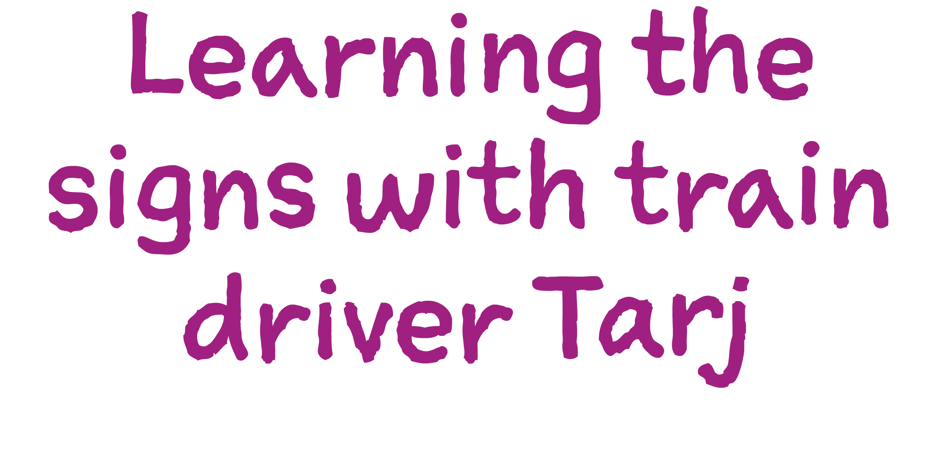

Slide 2
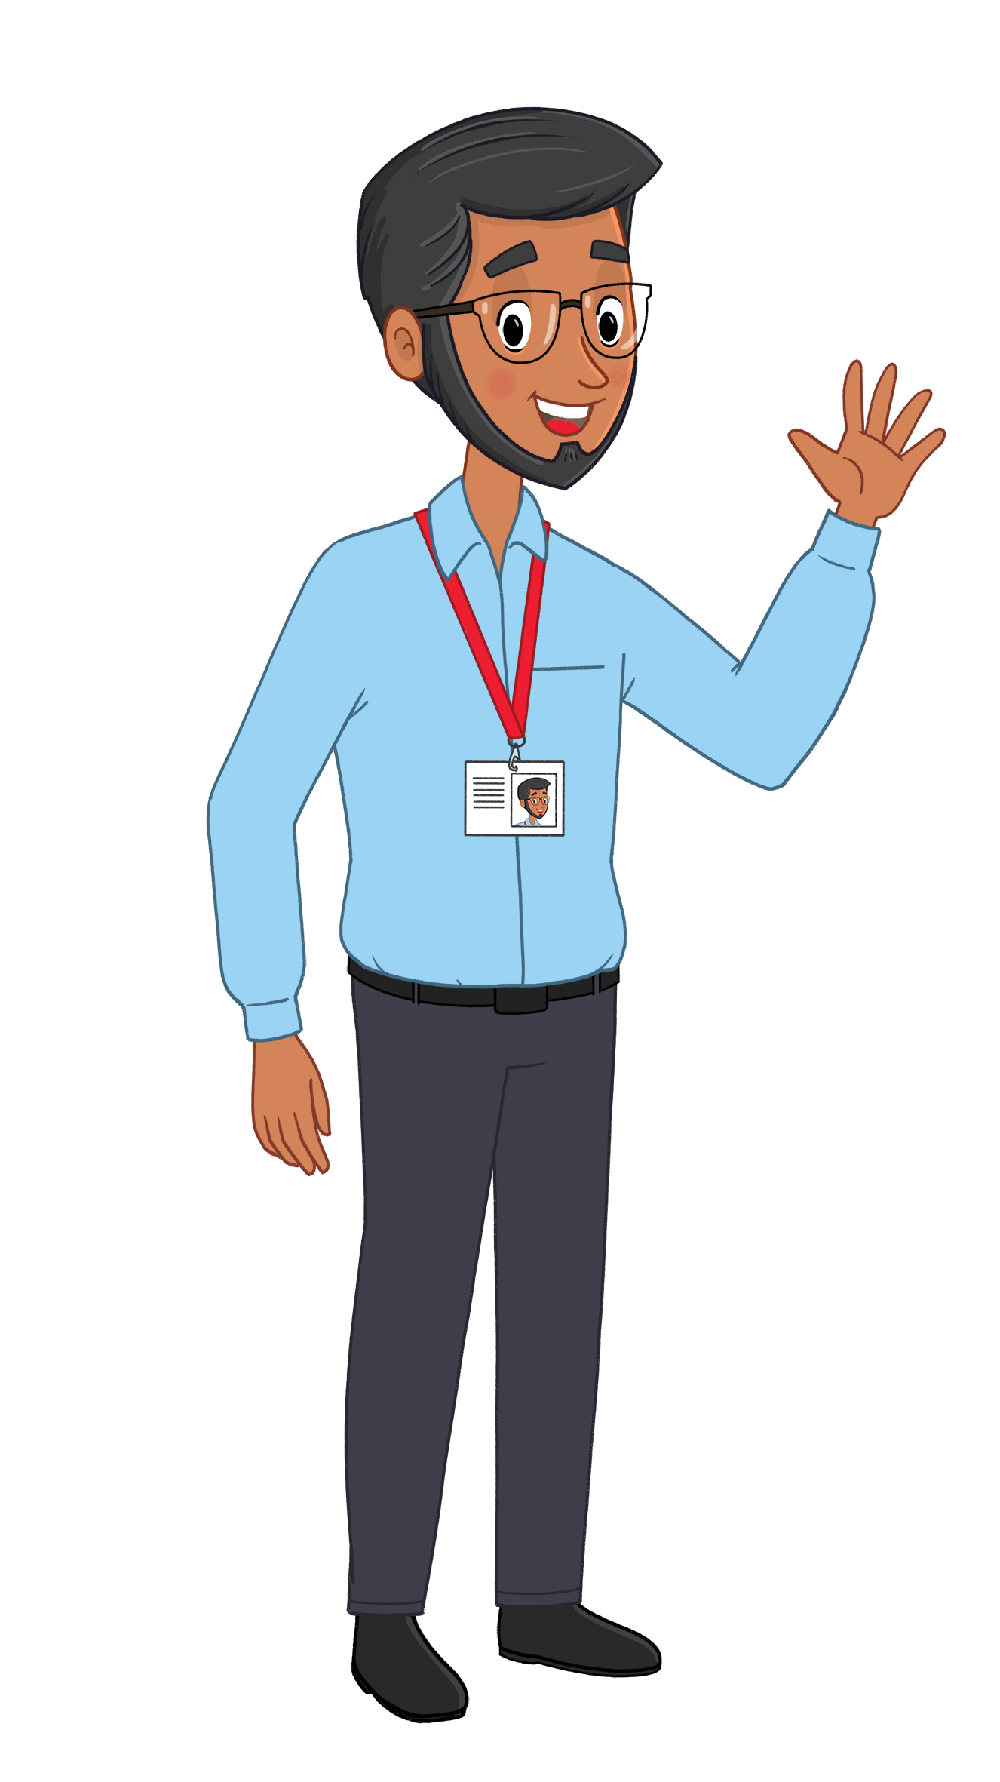
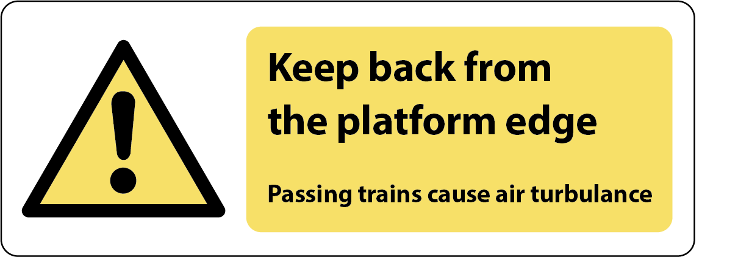
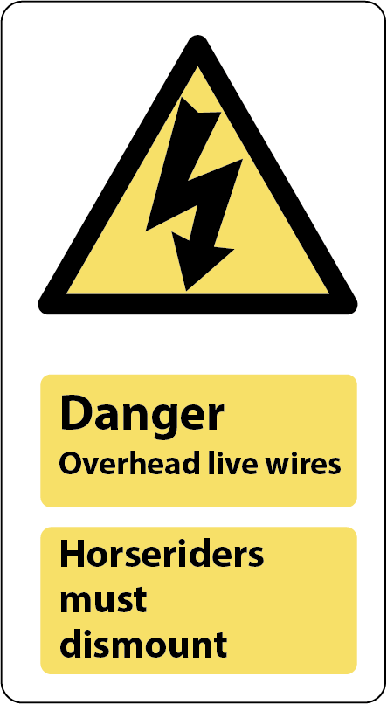
Slide 1
Are you Switched On and ready to test your knowledge of the train signs?
Get ready to earn your Switched On: Sign Spotter badge.
www.switchedonrailsafety.co.uk
Switched On Travels with Suzi 2

Slide 3
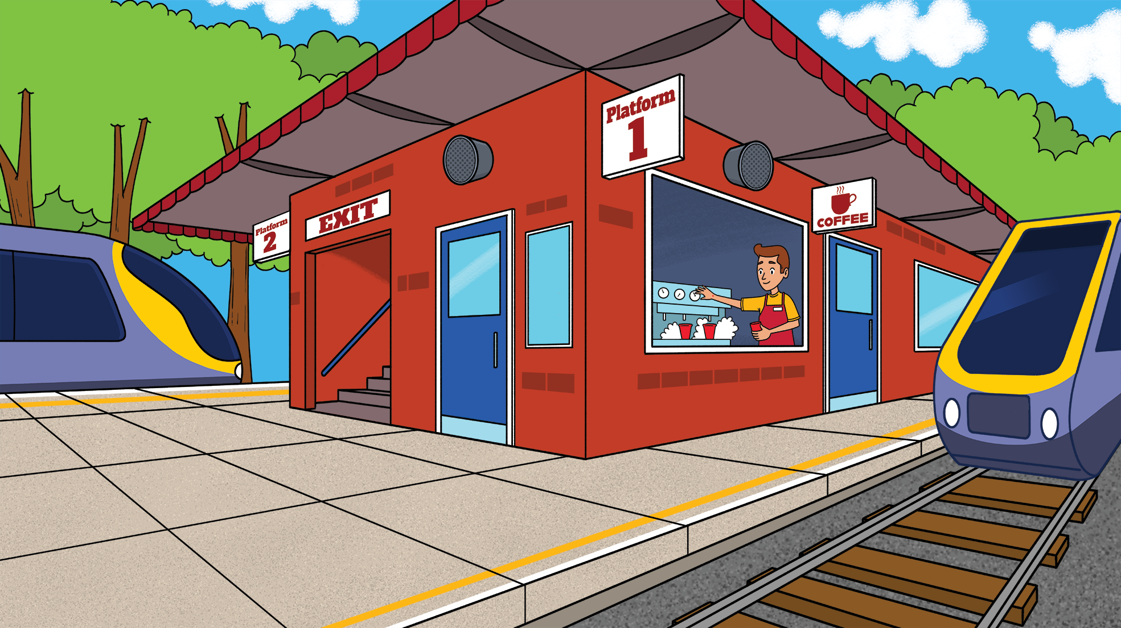
Slide 2
Let’s get started here.
This line isn’t a sign like some of the others we’re going to learn today but it is really important and it’s something we have to pay attention to.
What do we need to do when we see a yellow line on the platform?
www.switchedonrailsafety.co.uk
Switched On Travels with Suzi 3

Slide 4
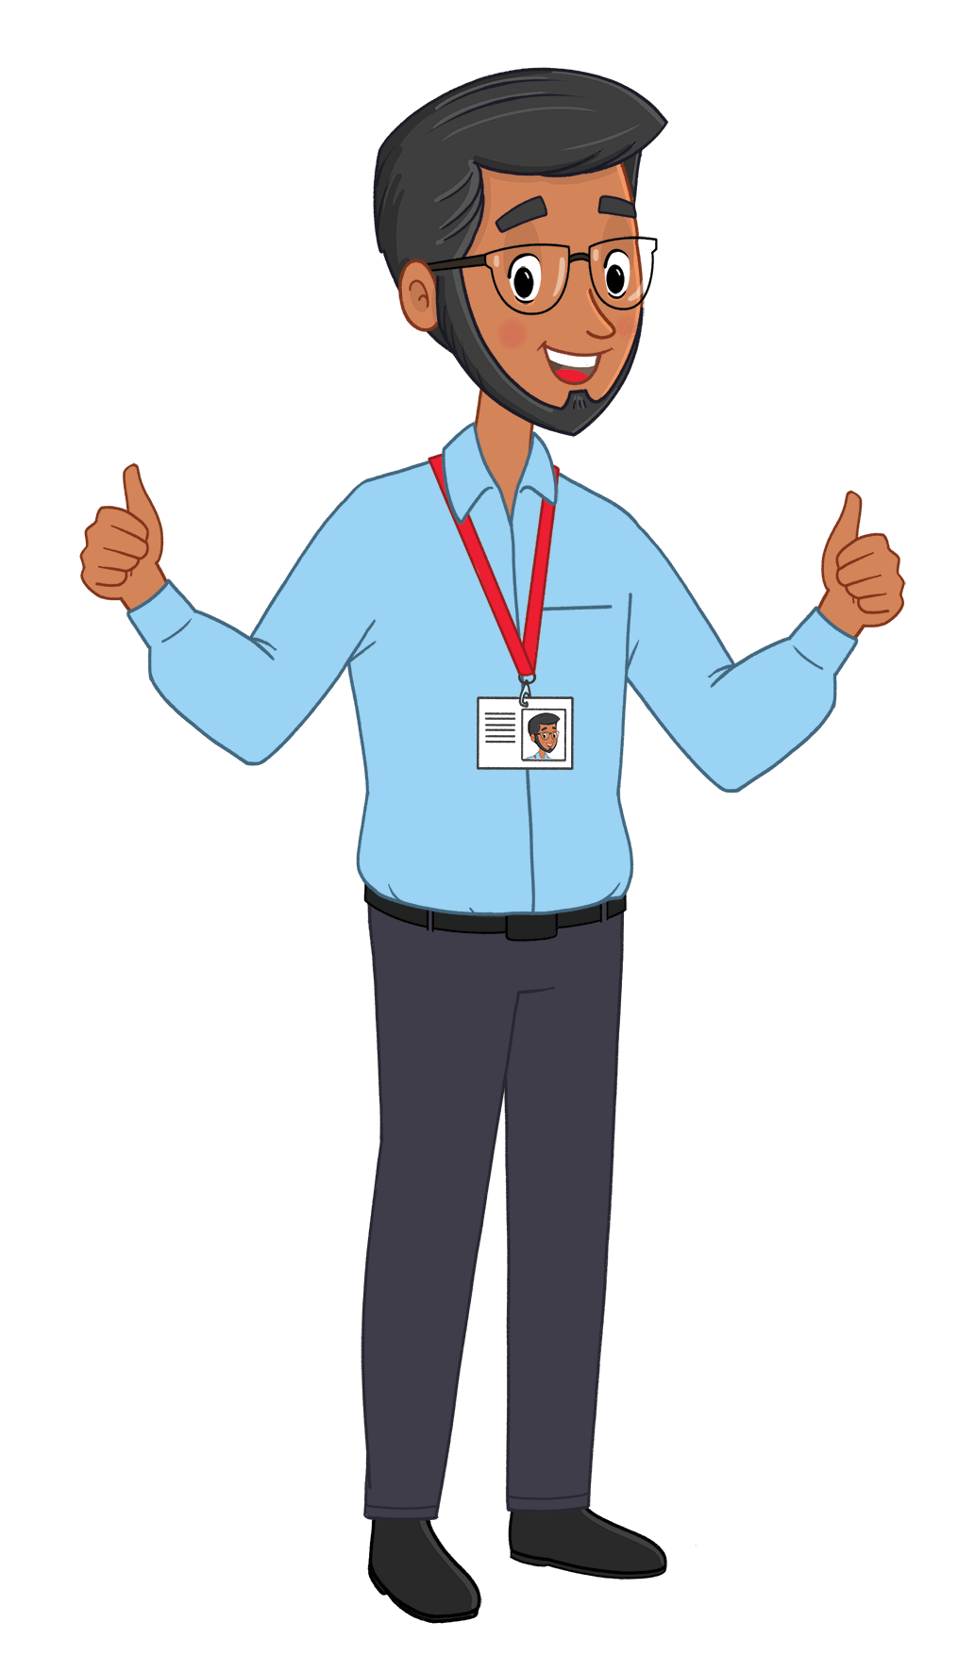
Slide 3
That’s right! We need to stand behind the yellow line. It will keep us safe from fast moving trains and ensures we don’t accidentally fall onto the tracks.
www.switchedonrailsafety.co.uk
Switched On Travels with Suzi 4

Slide 5
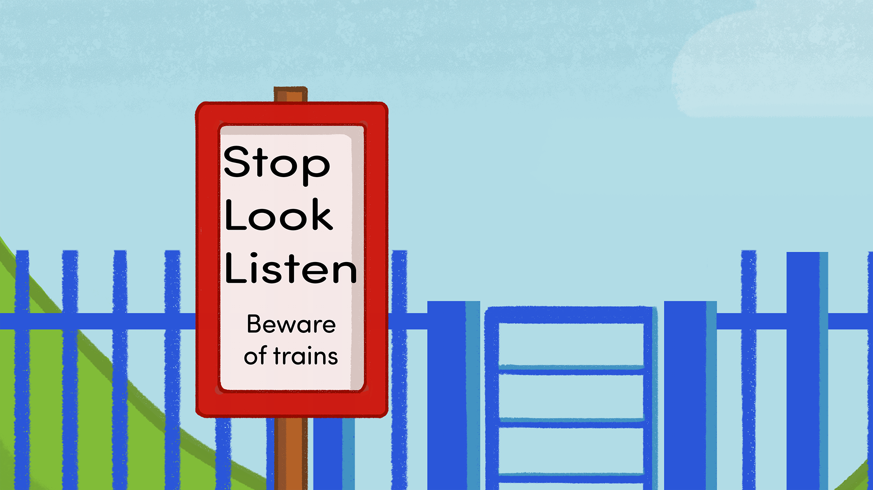
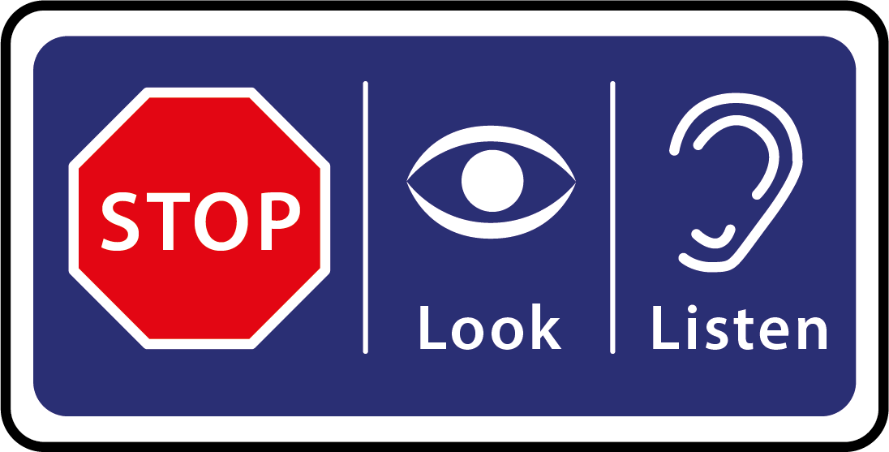
Slide 4
How about these signs?
What could they mean?
www.switchedonrailsafety.co.uk
Switched On Travels with Suzi 5

Slide 6
Slide 5
That’s right! You will find these signs at level crossings where the track and pavement or the track and road meet. These signs mean we need to Stop, Look and Listen to make sure that we are certain that a train is not nearby.
www.switchedonrailsafety.co.uk
Switched On Travels with Suzi 6

Slide 7
Slide 6
How about this sign? What could it mean?
www.switchedonrailsafety.co.uk
Switched On Travels with Suzi 7

Slide 8
Slide 7
Well done. This reminds us to keep away from the edge of the platform. Not all trains stop at all stations and they travel very quickly. It’s always best to hold an adult’s hand and stay right back when you are waiting for a train at the station.
www.switchedonrailsafety.co.uk
Switched On Travels with Suzi 8

Slide 9
Slide 8
Do you know what this sign means?
www.switchedonrailsafety.co.uk
Switched On Travels with Suzi 9

Slide 10
Slide 9
There’s an arrow in this picture and it has a strange shape - a little bit like lightning in a storm. This sign reminds us that there is often lots of electricity around the railways to make the trains move which could be dangerous. Remember, when we pay attention to the signs, we can stay safe around the railways.
www.switchedonrailsafety.co.uk
Switched On Travels with Suzi 10

Slide 11
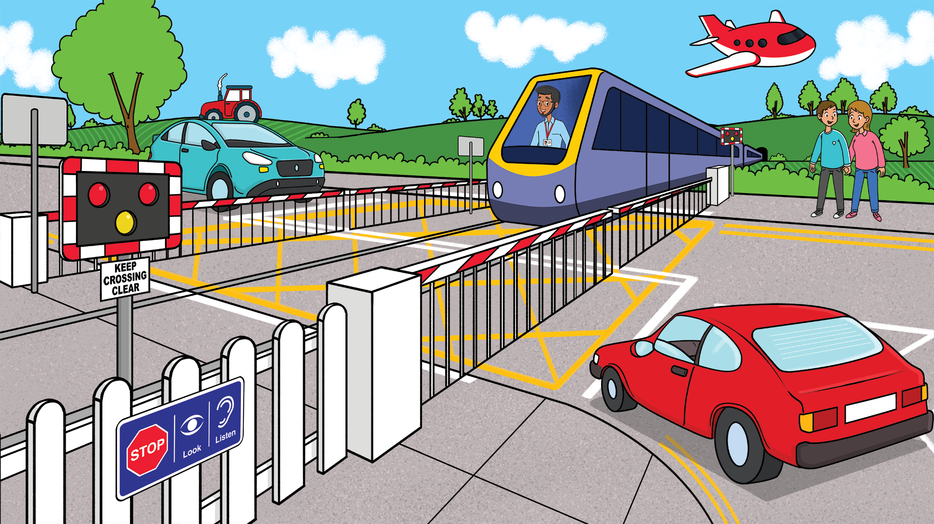
Slide 10
We’ve moved away from the station to a level crossing. This is where pavements and roads meet the track. The signs here help everyone to safely continue their journeys. Do you know what this sign means?
www.switchedonrailsafety.co.uk
Switched On Travels with Suzi 11

Slide 12
Slide 11
Great work. This sign reminds us that when the lights flash, we need to stay a safe distance away from the tracks. Sometimes there is a barrier that comes down to keep us away from the trains and the track. We need to pay attention, stop, look and listen and use the signs to help us know when it’s safe to cross. You might also hear an alarm to help you know when a train is coming. At times one or more trains will use the level crossing so we can only cross when the alarms stop, the barriers are raised and even then, we still need to stay Switched On and cross very carefully.
www.switchedonrailsafety.co.uk
Switched On Travels with Suzi 12

Slide 13
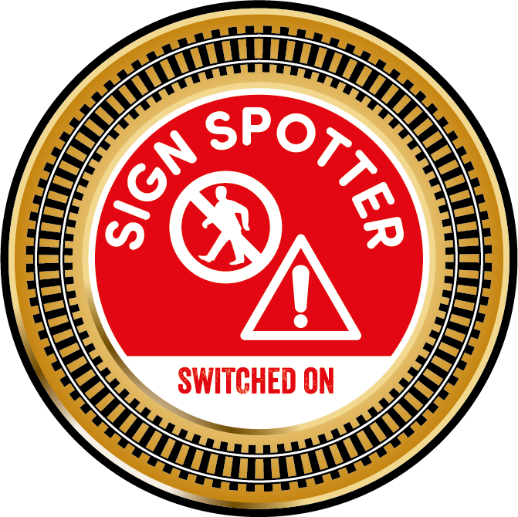
Slide 12
Congratulations!
You have stayed Switched On and shown how much you know about some of the signs that keep us safe around the railways. You have earned your Switched On: Sign Spotter badge!
www.switchedonrailsafety.co.uk
Switched On Travels with Suzi 13

