Slide 1




Slide 2


Question 1
What does it mean?
This is an advanced warning, instructing level crossing users that they must stop when the lights show as a train is due to pass over the crossing. This sign is also displayed at open crossings which do not close to traffic.
Where would you see it?
At level crossings.
Did you know even the emergency services aren’t allowed to go past when these lights are flashing!
www.switchedonrailsafety.co.uk
Sight-seeing: Are you Switched On? 2

Slide 3

Question 2
What does it mean?
You must pay attention to the lights. Stop means a train is on its way. You should wait for the light to turn green before crossing the tracks.
Where would you see it?
You will see this sign at some footpath or bridleway level crossings or private vehicle crossings.
www.switchedonrailsafety.co.uk
Sight-seeing: Are you Switched On? 3

Slide 4

Question 3
What does it mean?
Before crossing over the tracks you should Stop, Look and Listen to ensure a train isn’t approaching. Once you have checked thoroughly that a train isn’t approaching, carefully cross over the tracks.
Where would you see it?
At a level crossing where there is no other forms of protection like lights or barriers.
www.switchedonrailsafety.co.uk
Sight-seeing: Are you Switched On? 4

Slide 5

Question 4
What does it mean?
A phone is nearby to use in case of emergency, and also to obtain permission to cross
Where would you see it?
At a level crossing. But be aware that if there isn’t an emergency phone, there will always be a number you can call in an emergency.
The signs will tell you if you need to phone.
www.switchedonrailsafety.co.uk
Sight-seeing: Are you Switched On? 5

Slide 6
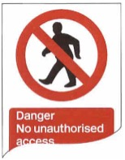
Question 5
What does it mean?
You can’t go further than this sign as it could be dangerous.
Where would you see it?
At stations.
www.switchedonrailsafety.co.uk
Sight-seeing: Are you Switched On? 6

Slide 7

Question 6
What does it mean?
That the level crossing in front of you does not have a barrier or gates. You must Stop, Look and Listen in order to ensure it is safe to cross the tracks.
Where would you see it?
At a level crossing where there is no barrier. These types of level crossings are usually found in rural areas where cars have to give way to trains.
www.switchedonrailsafety.co.uk
Sight-seeing: Are you Switched On? 7

Slide 8

Question 7
What does it mean?
This indicates that there is a level crossing ahead that uses either automatic barriers or gates operated manually by railway staff.
Where would you see it?
At a level crossing that has a gate or a barrier.
www.switchedonrailsafety.co.uk
Sight-seeing: Are you Switched On? 8

Slide 9

Question 8
What does it mean?
If the lights at a level crossing continue to show, another train may be approaching.
The sound that the warning makes changes when this happens too so you know there is a second train approaching.
Where would you see it?
At a level crossing.
www.switchedonrailsafety.co.uk
Sight-seeing: Are you Switched On? 9

Slide 10

Question 9
What does it mean?
This is a reminder that trains don’t always sound their horns as they approach level crossings and only do so if you’re too far out to be able to see.
Where would you see it?
Level crossings.
www.switchedonrailsafety.co.uk
Sight-seeing: Are you Switched On? 10

Slide 11
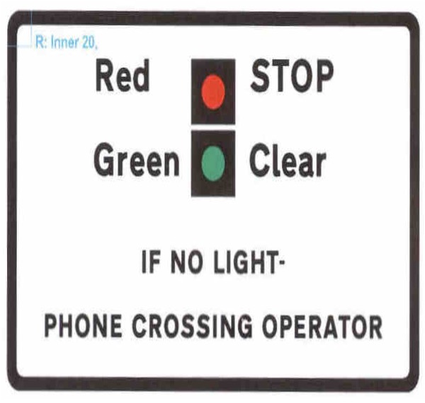
Question 10
What does it mean?
If the light is not showing red or green you must call the operator to discuss crossing the tracks safely.
Where would you see it?
At a level crossing.
www.switchedonrailsafety.co.uk
Sight-seeing: Are you Switched On? 11

Slide 12
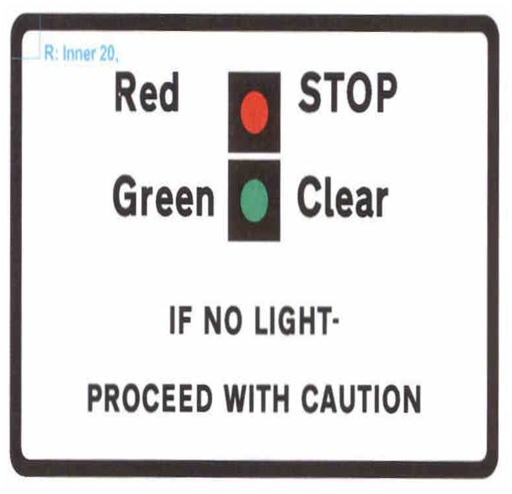
Question 11
What does it mean?
If the light is not showing red or green you must Stop, Look and Listen and only proceed over the tracks if you are sure that there is no oncoming train.
Where would you see it?
At a level crossing.
www.switchedonrailsafety.co.uk
Sight-seeing: Are you Switched On? 12

Slide 13
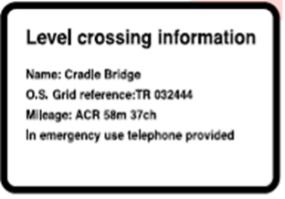
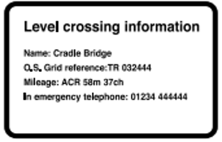
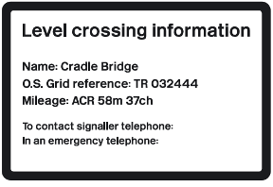
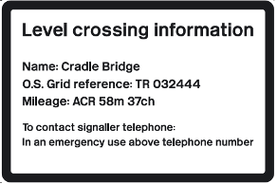
Question 12
Can you spot the difference with these signs and say where you might find them?
What does it mean?
These signs display different instructions of what to do in an emergency. It’s always important to read signs carefully . Sometimes there might be an emergency phone you can use, in others there will be specific numbers to call to report an emergency.
Where would you see it?
At a level crossing.
www.switchedonrailsafety.co.uk
Sight-seeing: Are you Switched On? 13

Slide 14
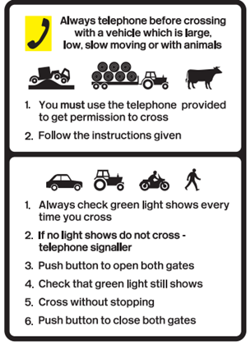
Question 13
What does it mean?
There are many different types of level crossings. There may be red and green lights to indicate if it’s safe to cross. If no light shows you need to use the telephone provided to call and check if it is safe to cross over the tracks.
Where would you see it?
At a level crossing.
www.switchedonrailsafety.co.uk
Sight-seeing: Are you Switched On? 14

Slide 15
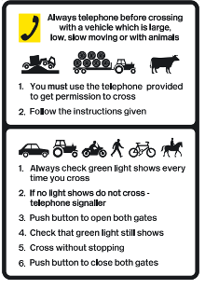
Question 14
What does it mean?
There are many different types of level crossings. There may be red and green lights to indicate if it’s safe to cross. If no light shows you need to use the telephone provided to call and check if it is safe to cross over the tracks.
Where would you see it?
At a level crossing.
www.switchedonrailsafety.co.uk
Sight-seeing: Are you Switched On? 15

Slide 16
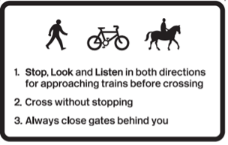
Question 15
What does it mean?
There are many different types of level crossings. At this one there is a gate to protect you. You must Stop, Look and Listen to check that a train is not approaching before crossing over safely.
Where would you see it?
At a level crossing.
www.switchedonrailsafety.co.uk
Sight-seeing: Are you Switched On? 16

Slide 17
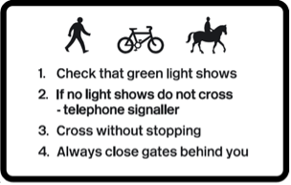
Question 16
What does it mean?
There are many different types of level crossings. At this one there are lights and a gate to protect you. If no light shows you must telephone the signaller to check if that a train is not approaching.
Where would you see it?
At a level crossing.
www.switchedonrailsafety.co.uk
Sight-seeing: Are you Switched On? 17

