Slide 1

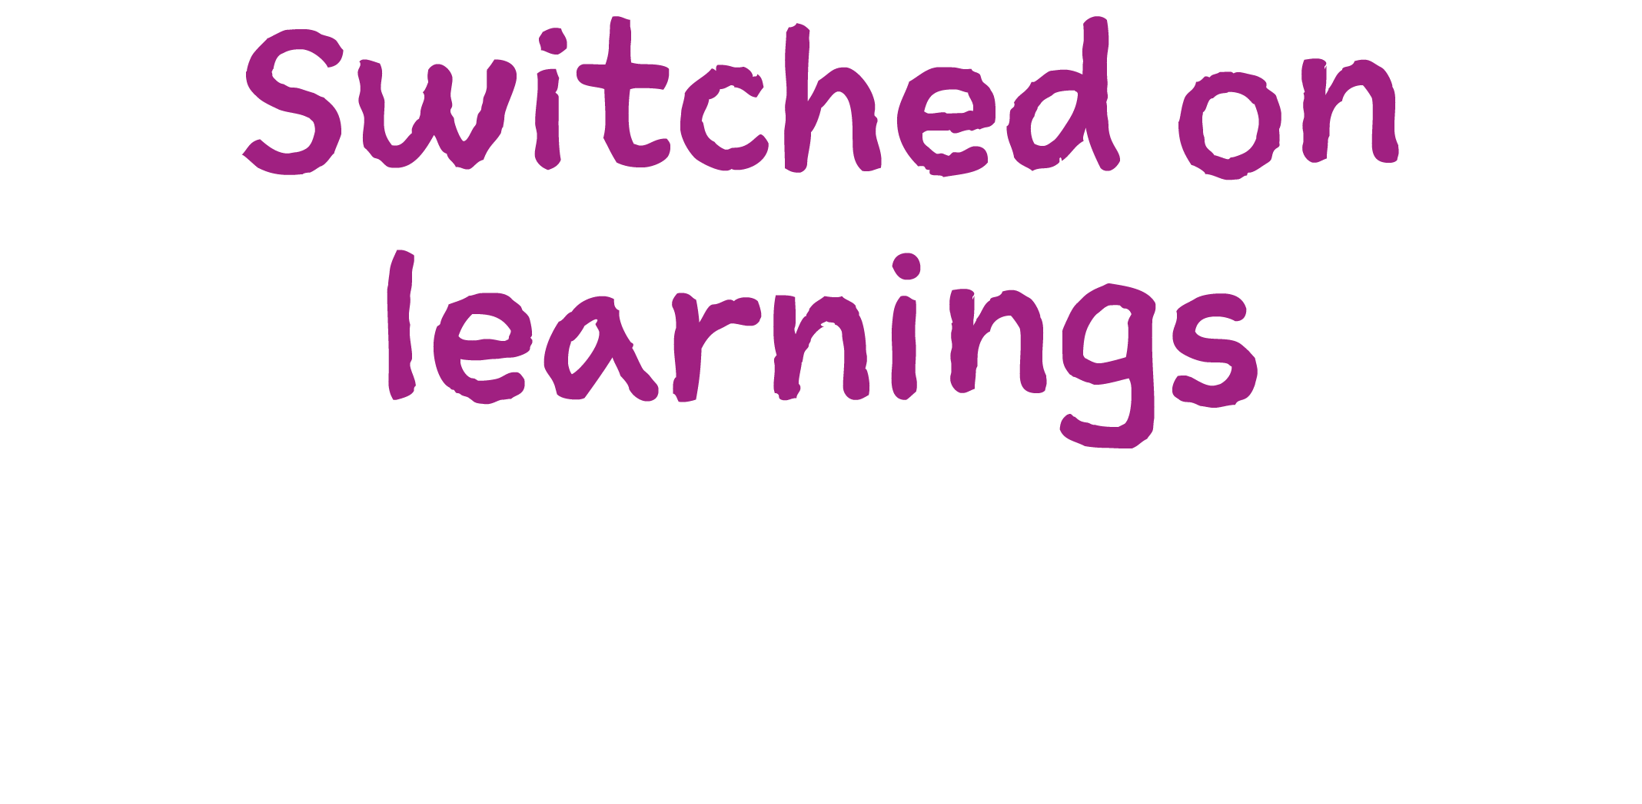


Slide 2
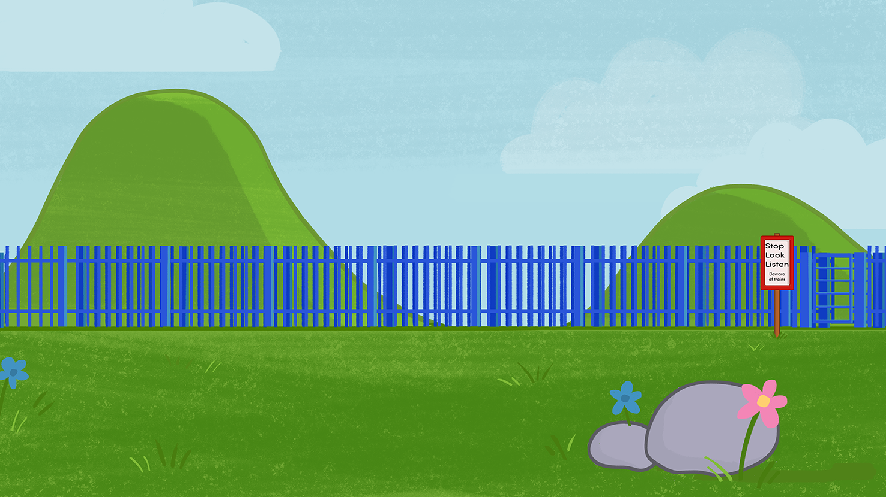
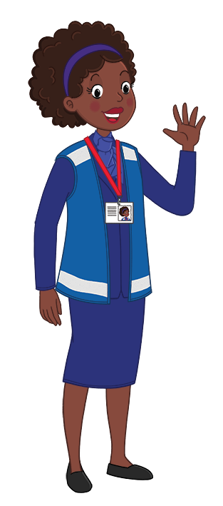
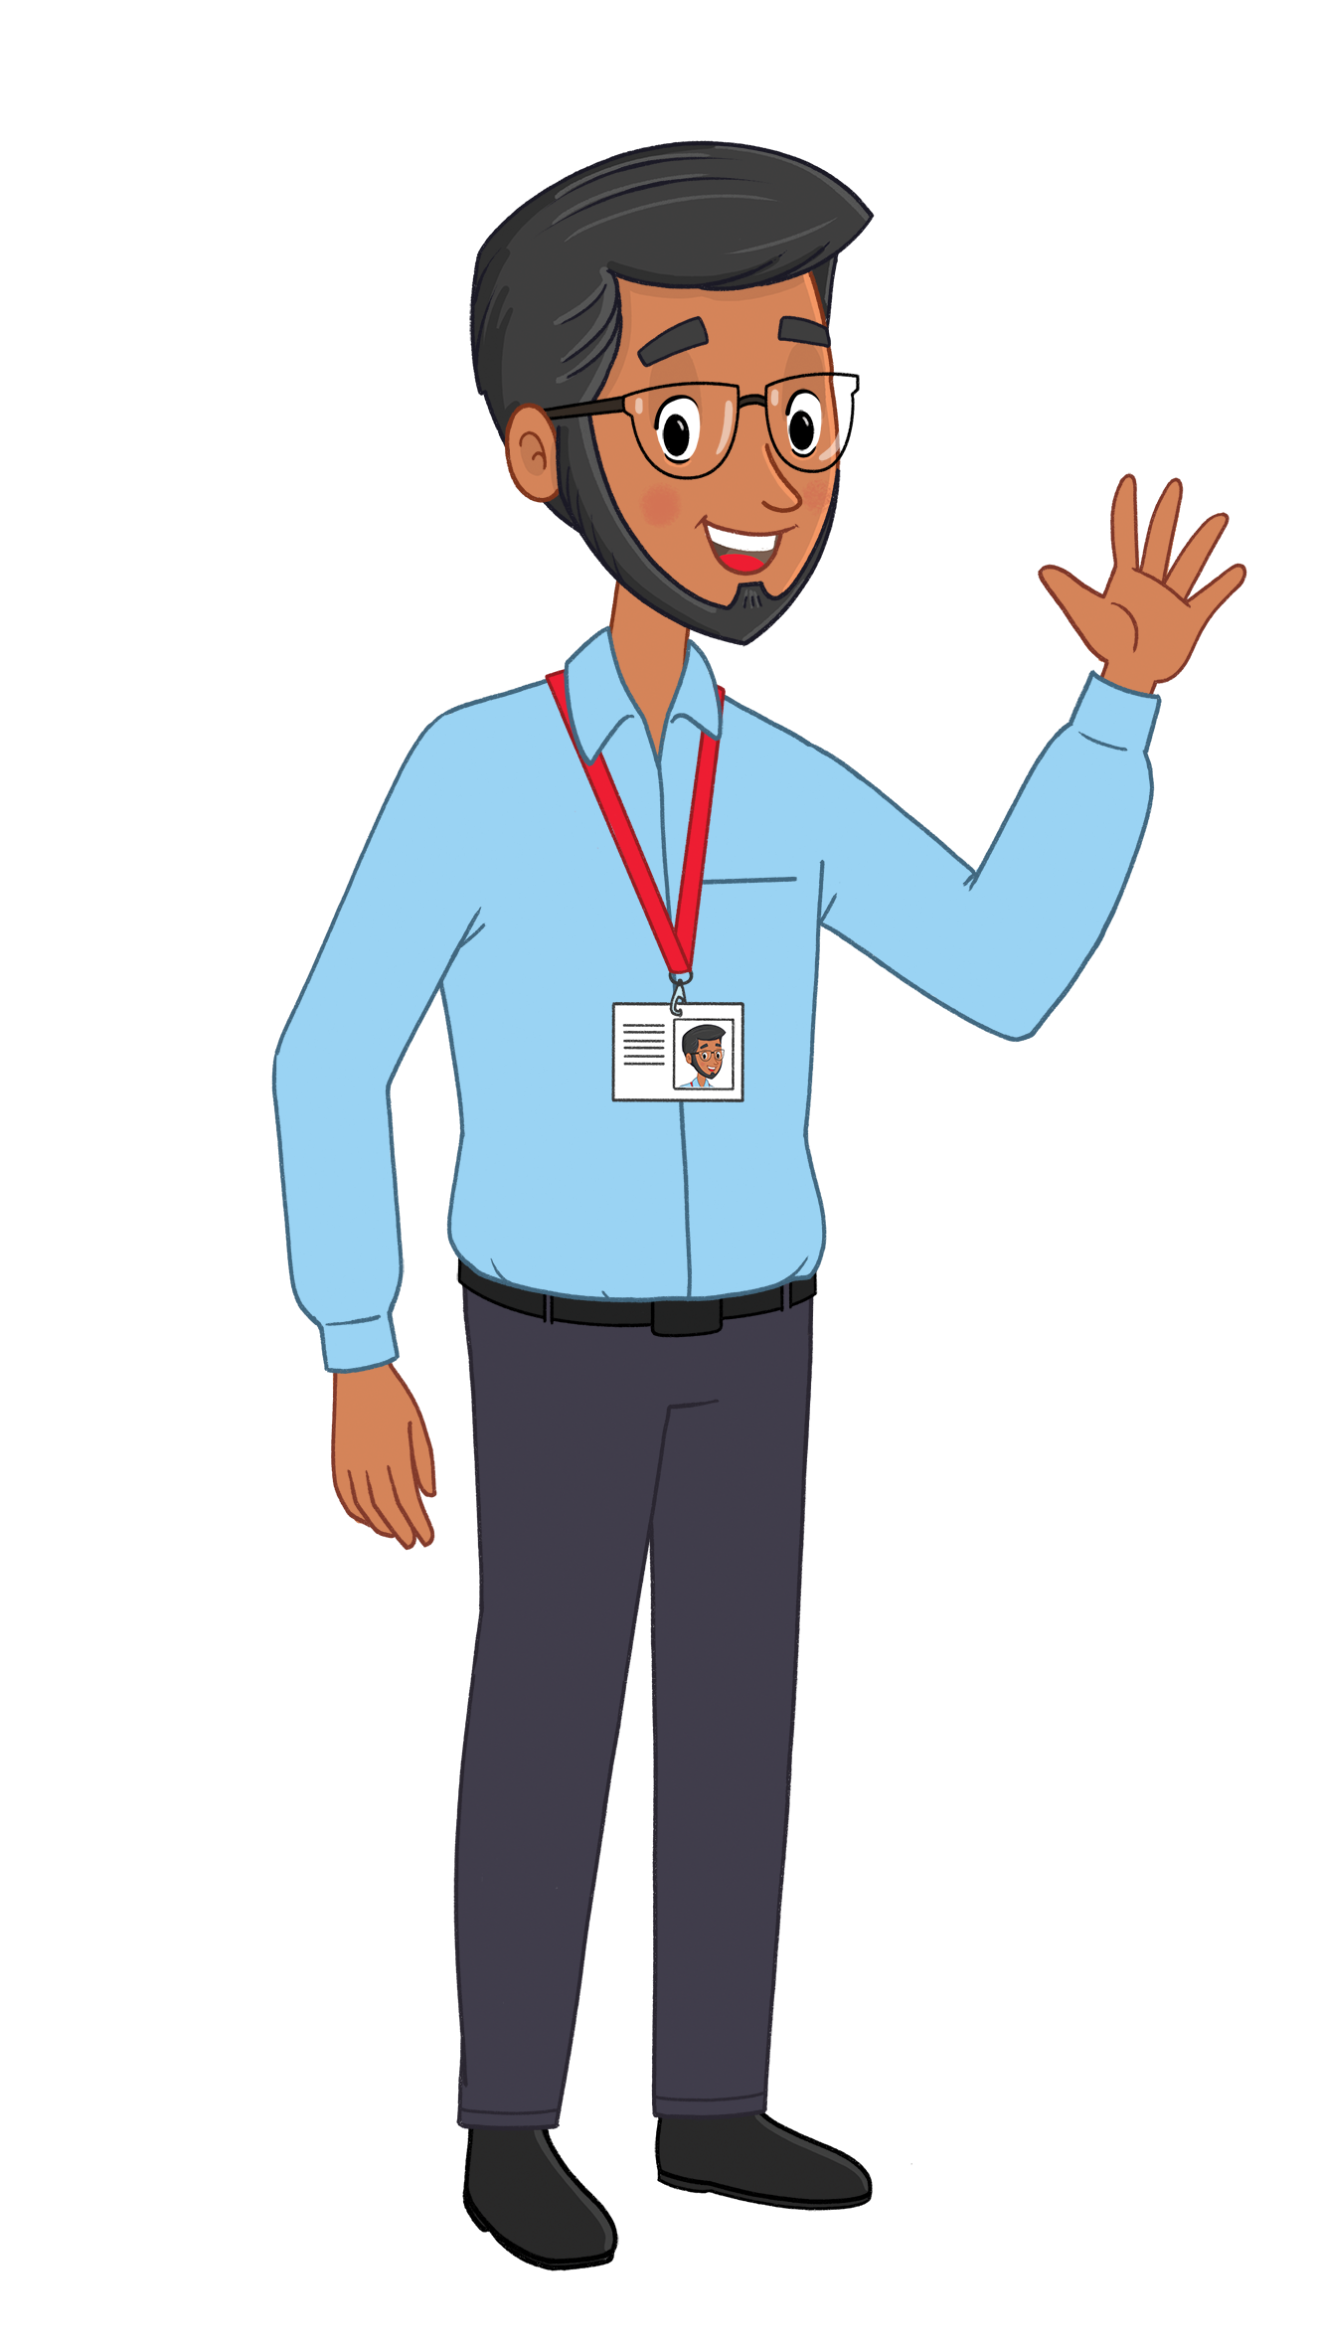
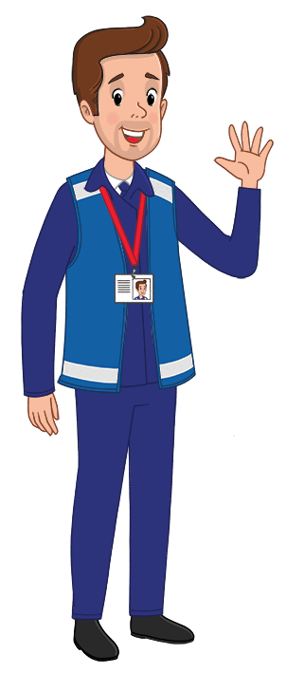
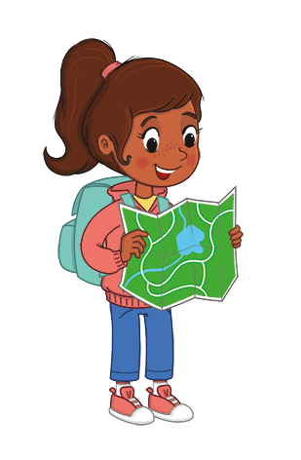

Slide 1
Are you ready to test your learning?
Let’s get started and see if you can answer the questions correctly about staying Switched On.
www.switchedonrailsafety.co.uk
Switched On Travels with Suzi 2

Slide 3
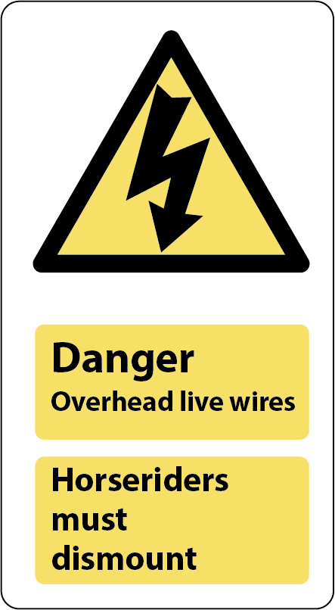
Slide 2
What does this sign mean?
That’s it. This sign warns us about the electricity around the tracks.
www.switchedonrailsafety.co.uk
Switched On Travels with Suzi 3

Slide 4
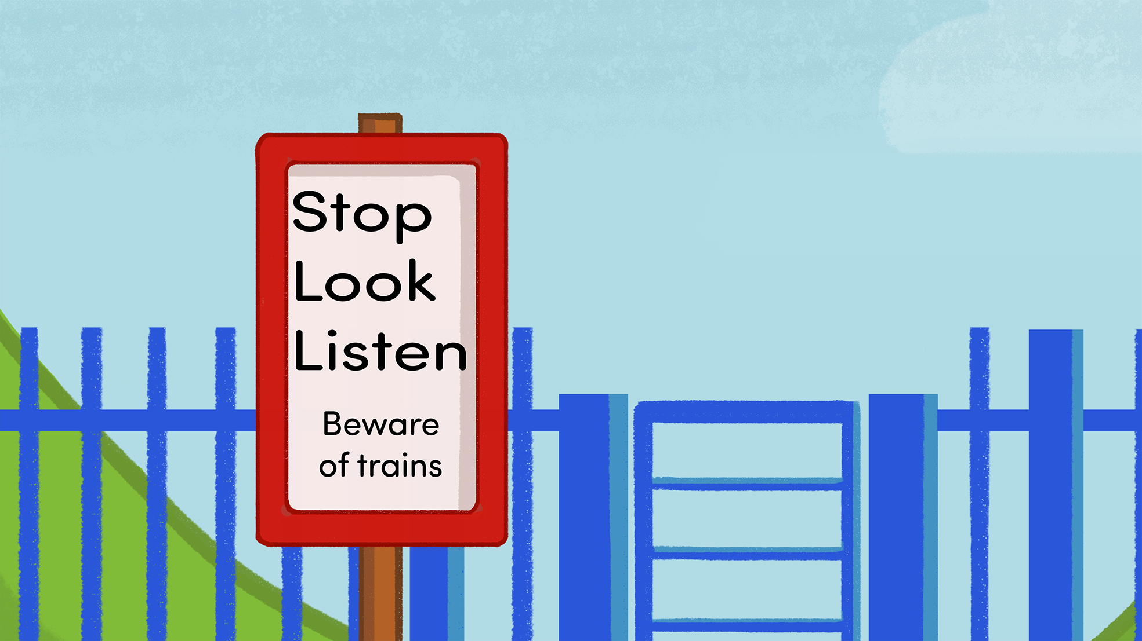

Slide 3
What do these sign mean?
Great work. You will find these signs near level crossings where the track and pavement or the track and road meet. These signs mean we need to Stop, Look and Listen to make sure that we are certain that a train is not nearby.
www.switchedonrailsafety.co.uk
Switched On Travels with Suzi 4

Slide 5
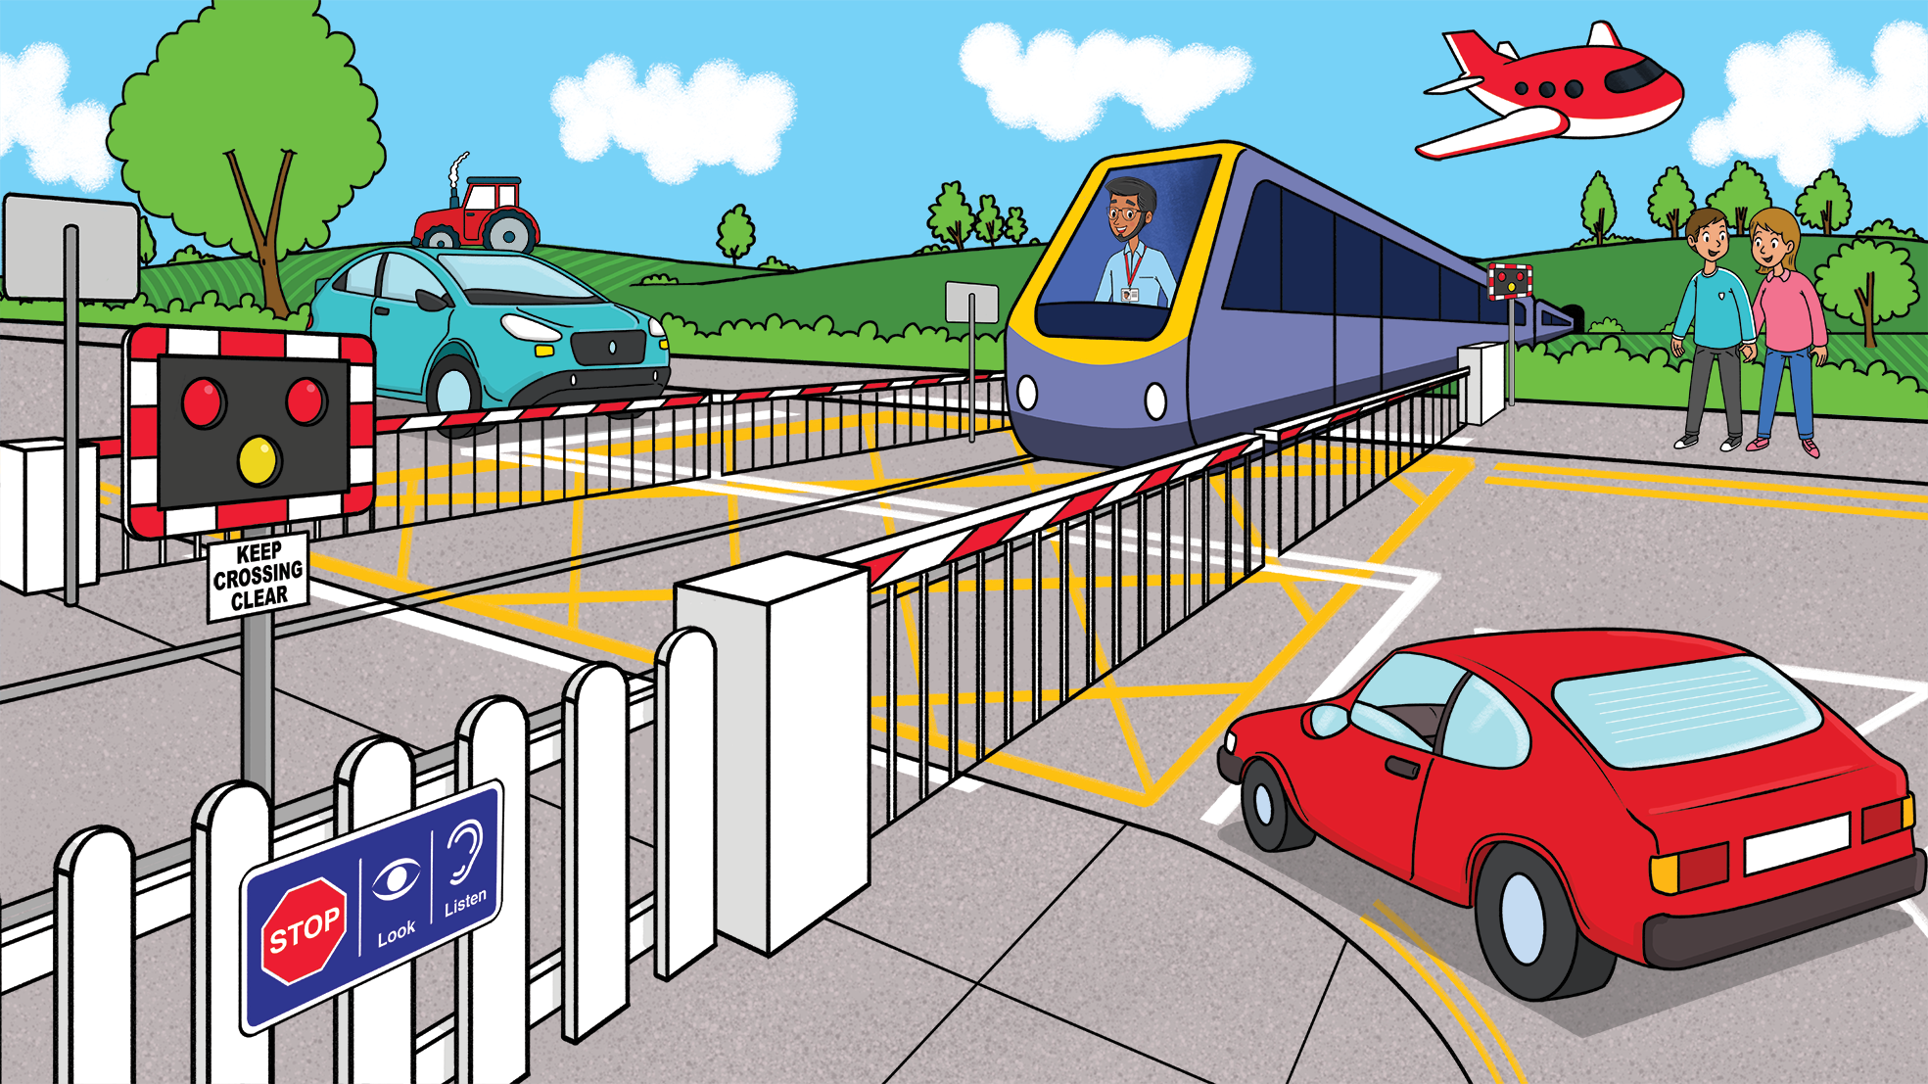
Slide 4
What does this sign mean?
That’s right when we see these lights flashing we need to stop at the Level Crossing and wait until it’s safe to cross.
www.switchedonrailsafety.co.uk
Switched On Travels with Suzi 5

Slide 6
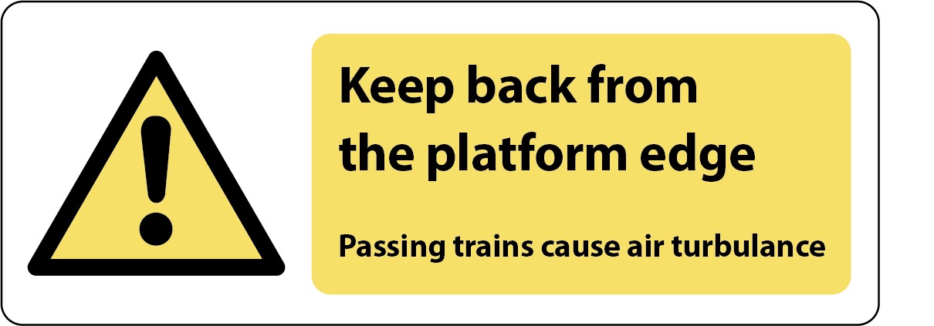
Slide 5
What does this sign mean?
Well done, this sign reminds us how it’s important to stand back from the platform edge. You can also hold an adult’s hand to stay super Switched On.
www.switchedonrailsafety.co.uk
Switched On Travels with Suzi 6

Slide 7
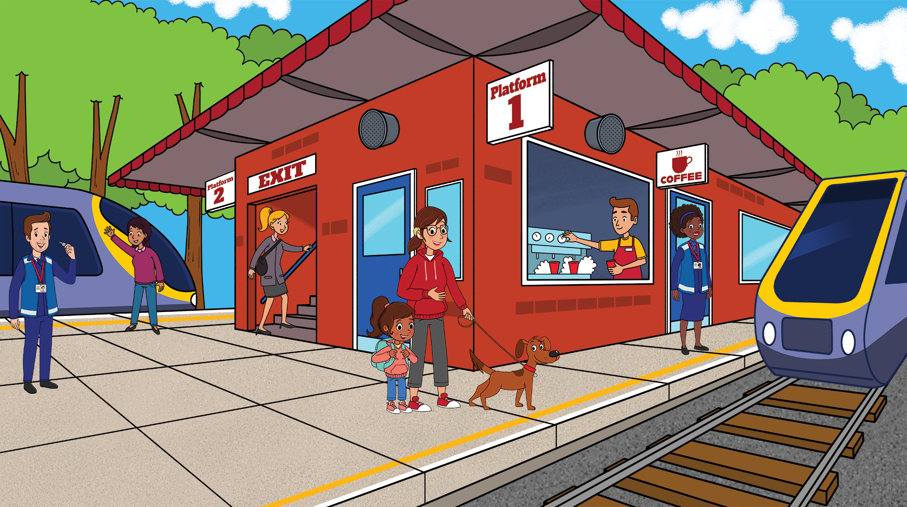
Slide 6
What does this line mean?
Brilliant work. We always need to remember to stand behind the yellow line
www.switchedonrailsafety.co.uk
Switched On Travels with Suzi 7

Slide 8

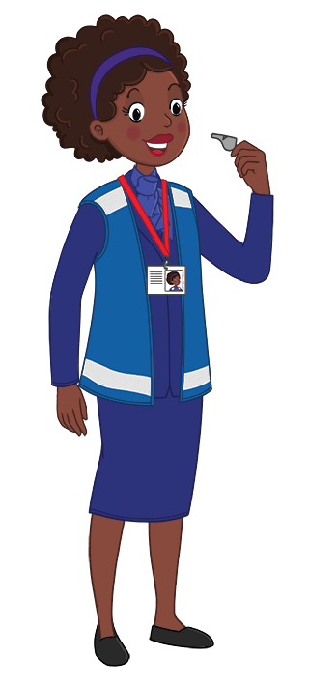
Slide 7
What should you do if you hear this sound?
This means that a train is departing. You should stay well back from the platform edge and make sure you don’t rush to try and get onboard. There will be another train along soon.
www.switchedonrailsafety.co.uk
Switched On Travels with Suzi 8

Slide 9
Slide 8
What should you do if you hear this sound?
A train is getting ready to depart. Time to stand away from the doors and the platform edge.
www.switchedonrailsafety.co.uk
Switched On Travels with Suzi 9

Slide 10
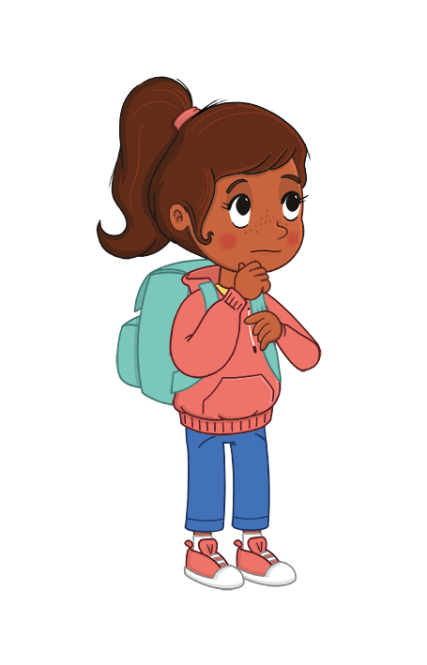
Slide 9
What should you do if you hear this sound?
This is an announcement that could be important to you. Listen carefully, announcements tell us about trains arriving and departing and could tell us if a fast train is approaching or if your train might be departing from a different platform.
www.switchedonrailsafety.co.uk
Switched On Travels with Suzi 10

Slide 11
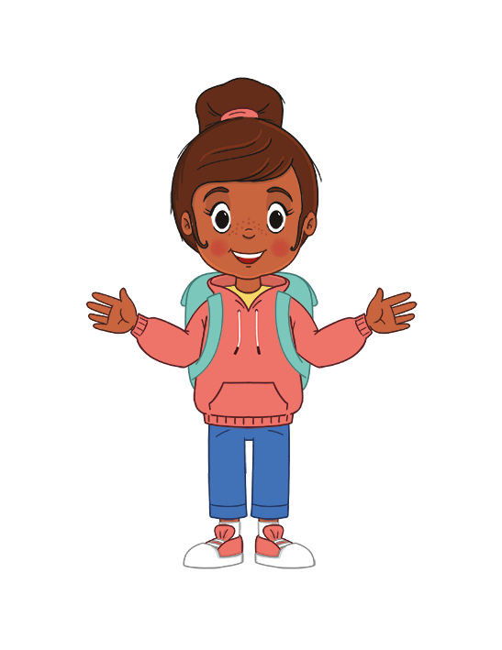
Slide 10
What should you do if you hear this sound?
This sound shows us that a train is approaching. We need to stay well back from the tracks and wait for the alarm to stop before checking it’s safe to cross over the tracks.
www.switchedonrailsafety.co.uk
Switched On Travels with Suzi 11

Slide 12
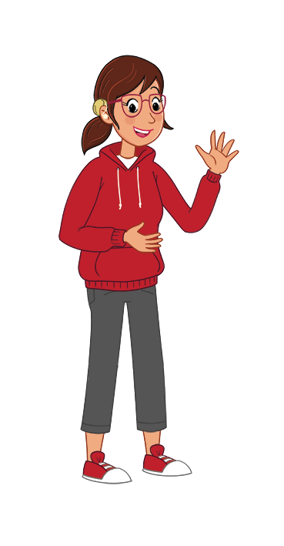
Slide 11
What should you do if you hear this sound?
This is a train horn. Train drivers sometimes use horns at level crossings before tunnels and if they are approaching people working on the train lines. This noise means that a train is approaching and we should stay Switched On and make sure we pay attention to the safety signs.
www.switchedonrailsafety.co.uk
Switched On Travels with Suzi 12

Slide 13
Slide 12
Which of these signs mean
stay back from the platform edge?
www.switchedonrailsafety.co.uk
Switched On Travels with Suzi 13

Slide 14
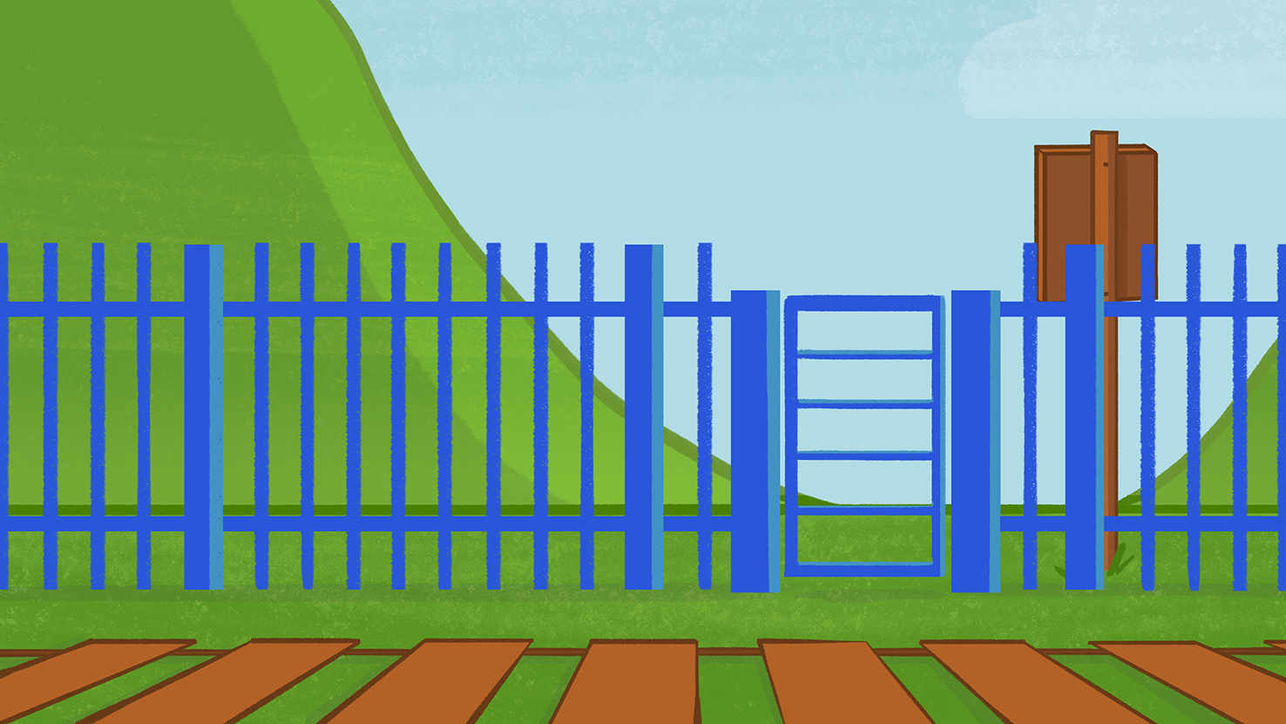
Slide 13
Where would you see this sign?
You find this sign near lots of level crossings
www.switchedonrailsafety.co.uk
Switched On Travels with Suzi 14

Slide 15
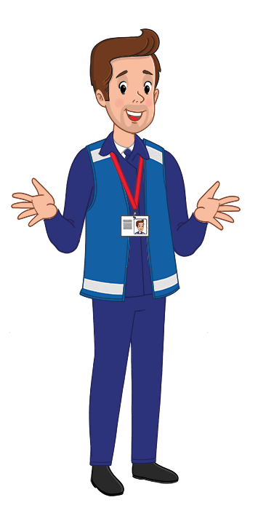
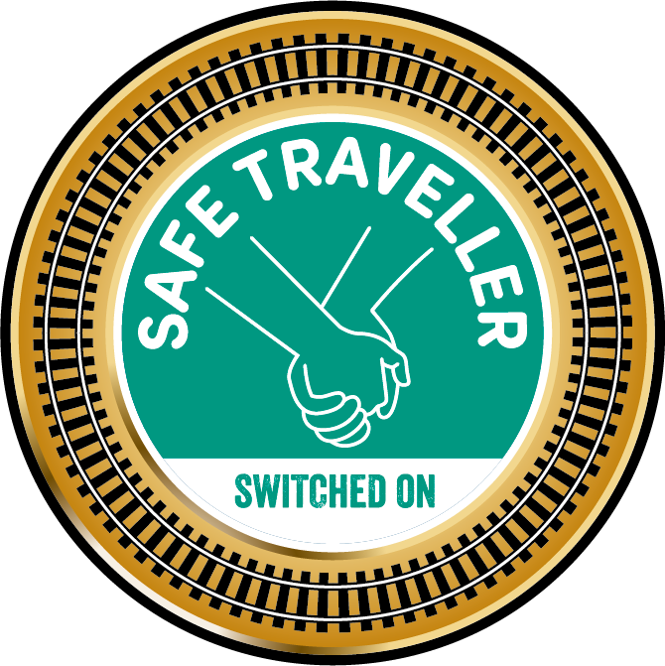
Slide 14
Well done!
You just earned your
Switched on: Safe traveller badge!
www.switchedonrailsafety.co.uk
Switched On Travels with Suzi 15

