Slide 1
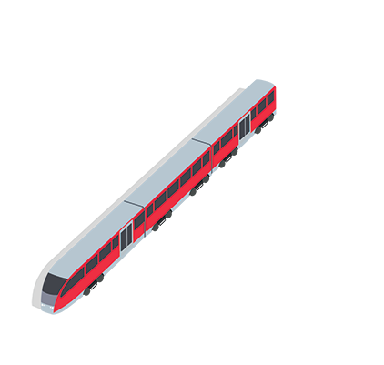

Slide 2
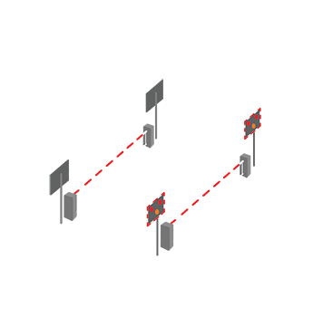
It’s time to test your knowledge
Work in small teams and write down your answers.
Which team can recall the most information?
www.switchedonrailsafety.co.uk
Who’s Switched On and safe for their next journey? 2

Slide 3
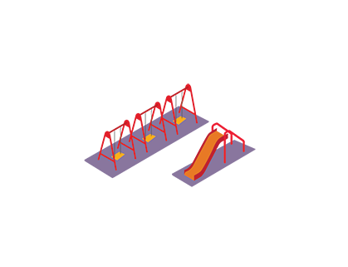
Question 1
True or false, it’s safe to cross railway tracks if there isn’t a train coming
False, it’s only safe if all of the safety signs tell you it’s safe to cross. Have the barriers returned to their upright position? Have the lights stopped flashing and the alarm sounding? In the event of a level crossing not having any barriers, have you stopped, looked and listened to ensure it’s safe to cross?
www.switchedonrailsafety.co.uk
Who’s Switched On and safe for their next journey? 3

Slide 4
Question 2
On average, a train is as heavy as…
200 tonnes
400 tonnes
600 tonnes
www.switchedonrailsafety.co.uk
Who’s Switched On and safe for their next journey? 4

Slide 5
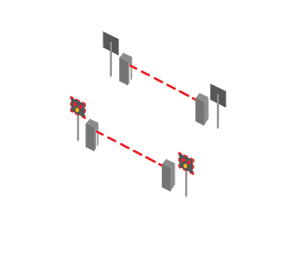
Question 3
It takes a high-speed train how many lengths of a football pitch to stop?
5 football pitches
10 football pitches
20 football pitches
www.switchedonrailsafety.co.uk
Who’s Switched On and safe for their next journey? 5

Slide 6
Question 4
True or false, level crossings always look the same?
False, some have barriers, lights and alarms, others may simply have a sign reminding you to Stop, Look and Listen to check it’s safe to cross the tracks.
www.switchedonrailsafety.co.uk
Who’s Switched On and safe for their next journey? 6

Slide 7
Question 5
Electricity can jump how many metres?
Up to 1 metre
Up to 3 metres
Up to 5 metres
www.switchedonrailsafety.co.uk
Who’s Switched On and safe for their next journey? 7

Slide 8
Question 6
The top speed for a train is…
90 mph
100 mph
125 mph
www.switchedonrailsafety.co.uk
Who’s Switched On and safe for their next journey? 8

Slide 9
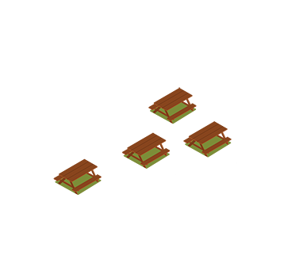
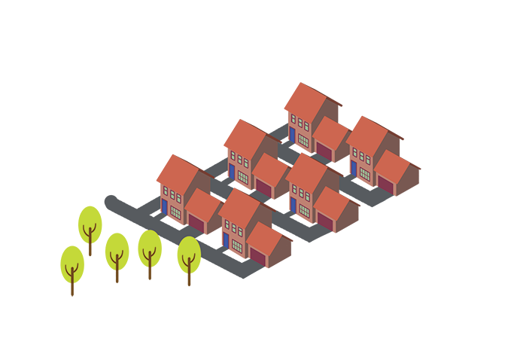
Question 7
A train can travel faster than a…
A cheetah
A car on the motorway
Anything under 125mph
www.switchedonrailsafety.co.uk
Who’s Switched On and safe for their next journey? 9

Slide 10
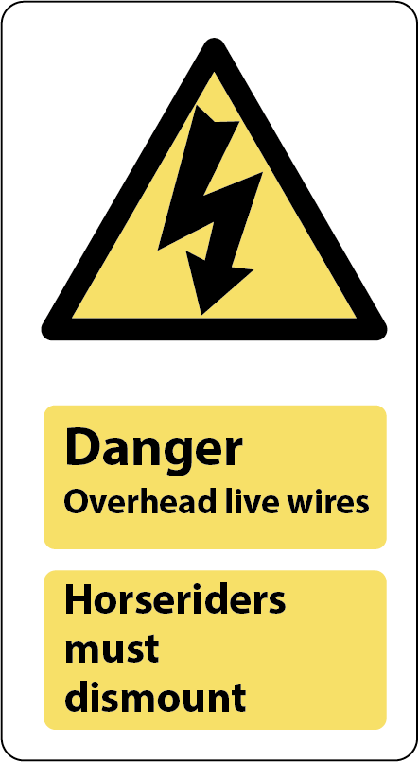
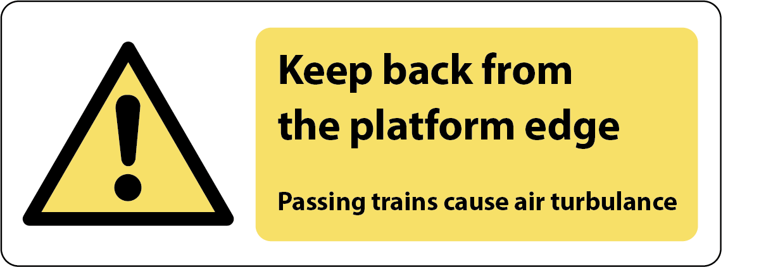
Question 8
One safety sign you might see on a station platform is… (draw it for an extra point)
www.switchedonrailsafety.co.uk
Who’s Switched On and safe for their next journey? 10

Slide 11
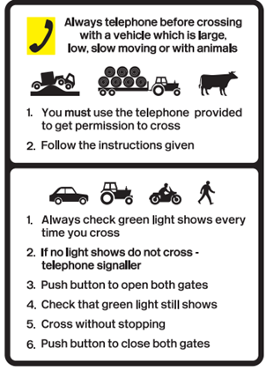
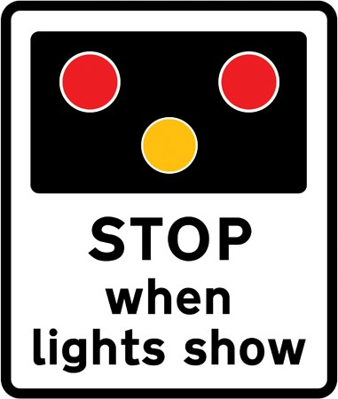
Question 9
One sign you might see at a level crossing is…
www.switchedonrailsafety.co.uk
Who’s Switched On and safe for their next journey? 11

Slide 12
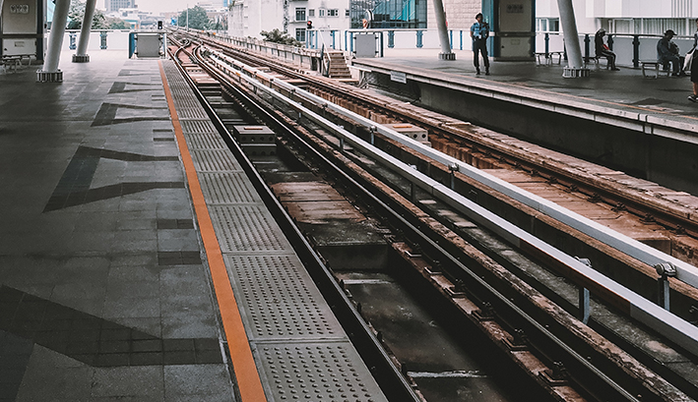
Question 10
The electrified rail is the _____ rail
Third
www.switchedonrailsafety.co.uk
Who’s Switched On and safe for their next journey? 12

Slide 13
Question 11
Electricity is turned off on the railways at…
This is a trick question, it is never turned off!
www.switchedonrailsafety.co.uk
Who’s Switched On and safe for their next journey? 13

Slide 14
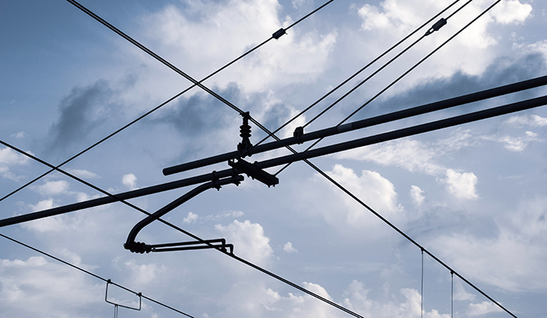
Question 12
True or false, electrical wires and rails are safe as long as you don’t touch them
False, electricity can ‘jump’ or travel up to 3 metres
www.switchedonrailsafety.co.uk
Who’s Switched On and safe for their next journey? 14

Slide 15
Question 13
Litter on the railway can cause…
Accidents and delays
www.switchedonrailsafety.co.uk
Who’s Switched On and safe for their next journey? 15

Slide 16
Question 14
True or false, the electrified rail looks exactly the same as the others?
True
www.switchedonrailsafety.co.uk
Who’s Switched On and safe for their next journey? 16

Slide 17
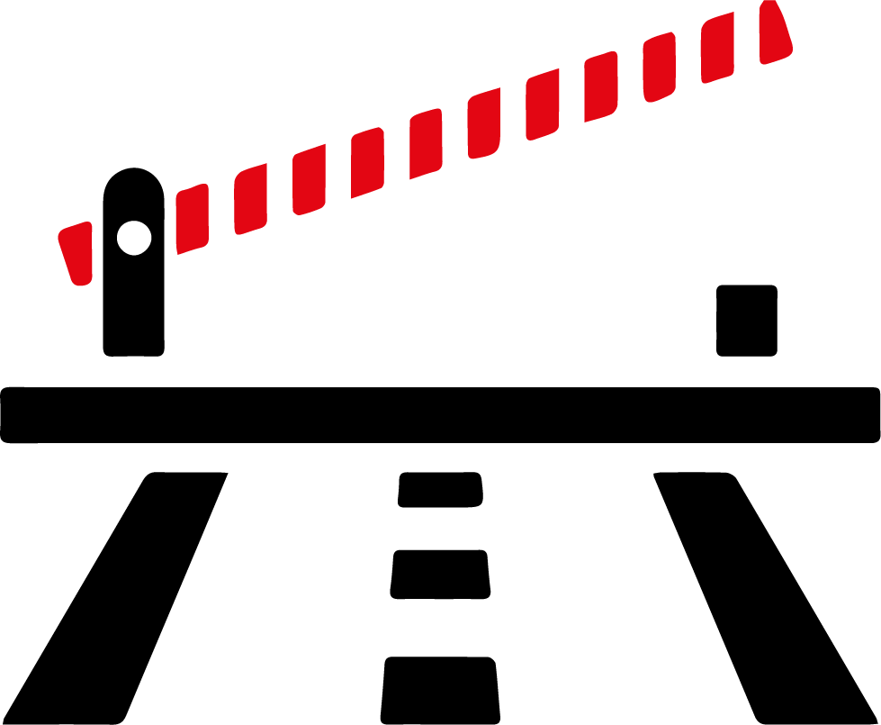
Question 15
The correct time to cross a level crossing after a train has passed is…
When the barriers have returned to their upright position, the lights have stopped flashing and the alarms have stopped. Even then you must remember to stop, look and listen.
www.switchedonrailsafety.co.uk
Who’s Switched On and safe for their next journey? 17

Slide 18
Question 16
True or false, you can always hear a train coming
False, some trains are almost silent
www.switchedonrailsafety.co.uk
Who’s Switched On and safe for their next journey? 18

Slide 19
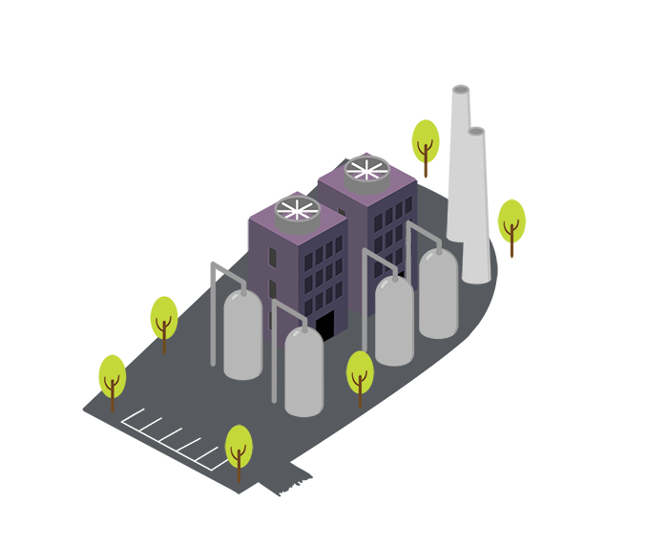
How many did you get right?
If you scored 12 or more, you are Switched On and ready to travel safely!
www.switchedonrailsafety.co.uk
Who’s Switched On and safe for their next journey? 19

