Slide 1




Slide 2


Slide 3
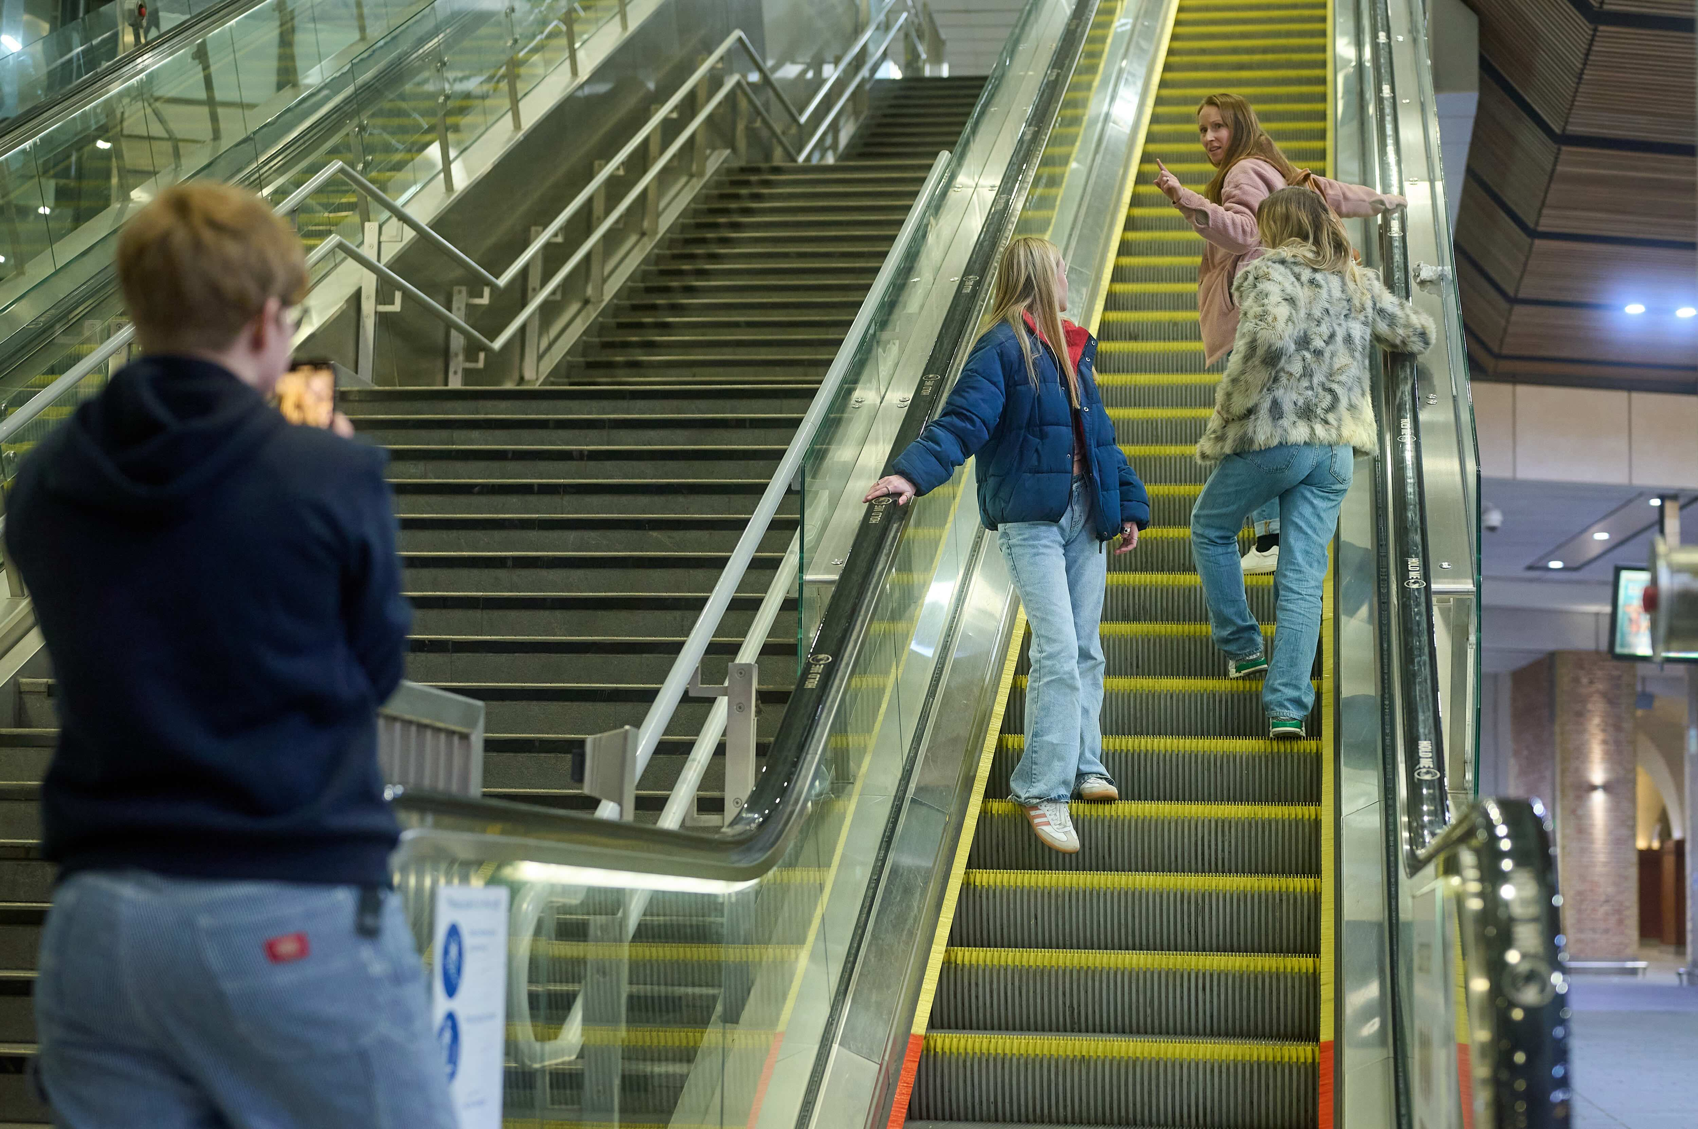

Escalator: The Fall – Scene 1
www.switchedonrailsafety.co.uk
Track Back 3

Slide 4
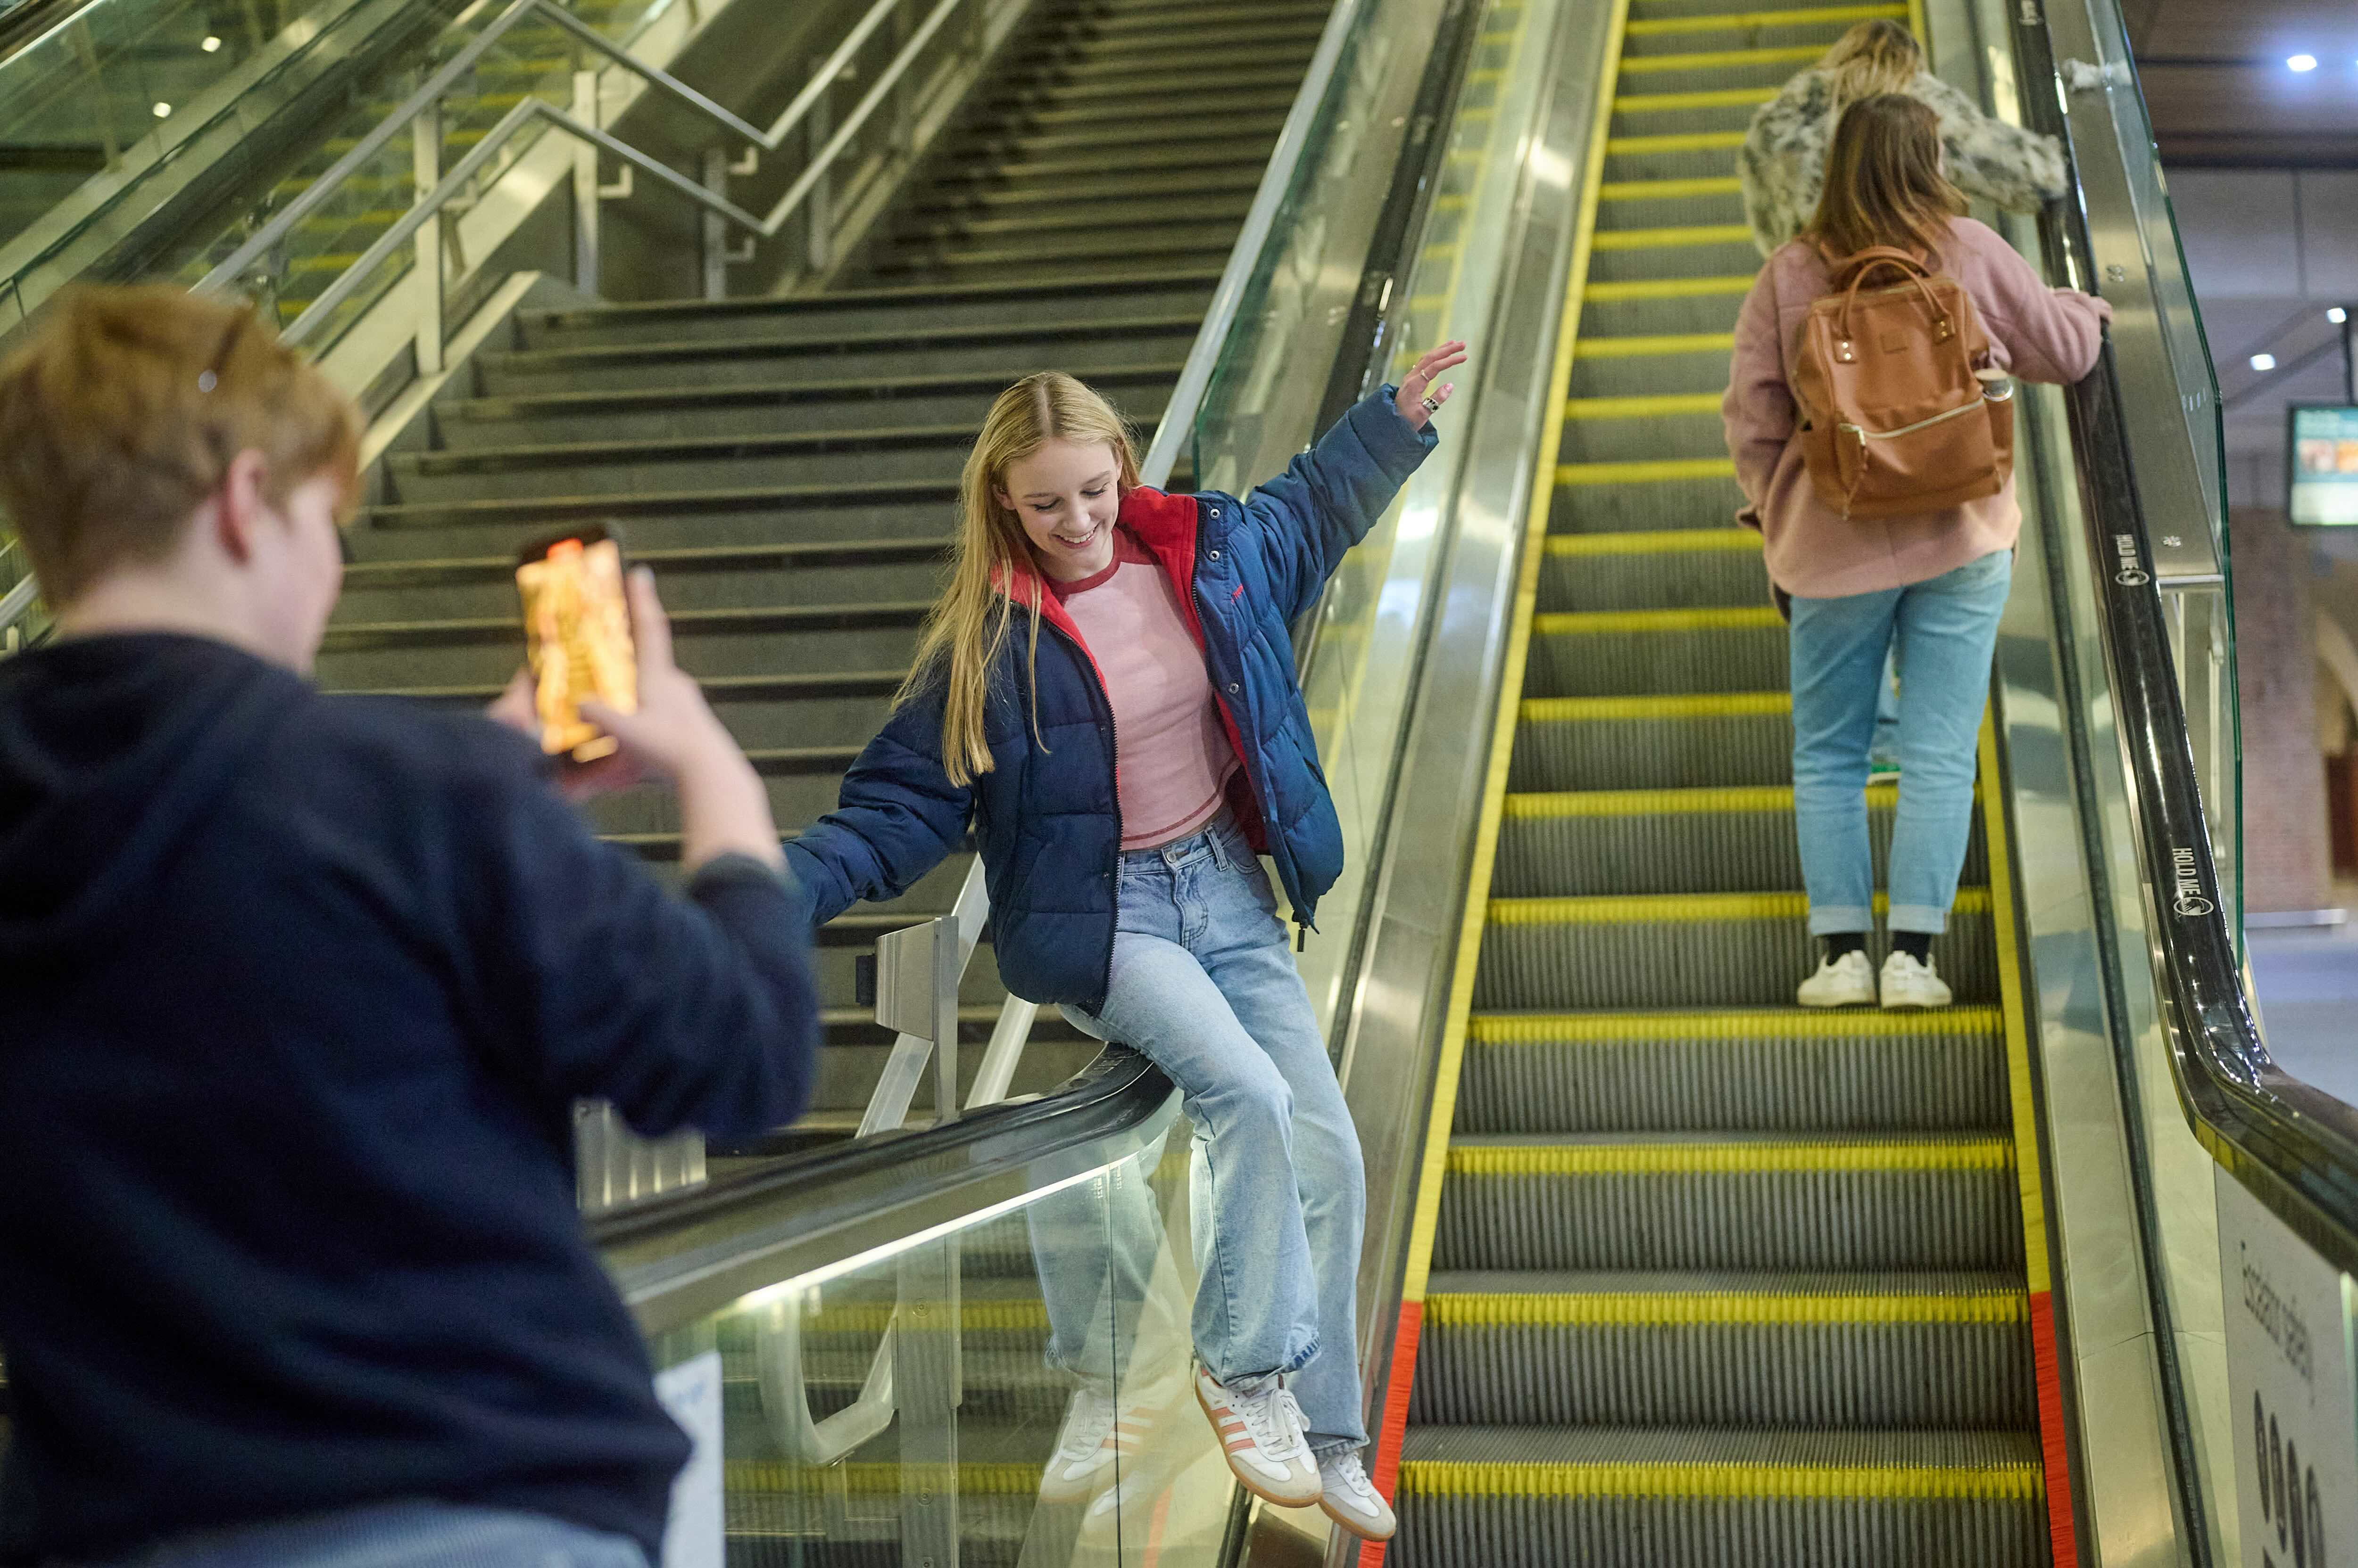
Escalator: The Fall – Scene 2
www.switchedonrailsafety.co.uk
Track Back 4

Slide 5


Slide 6
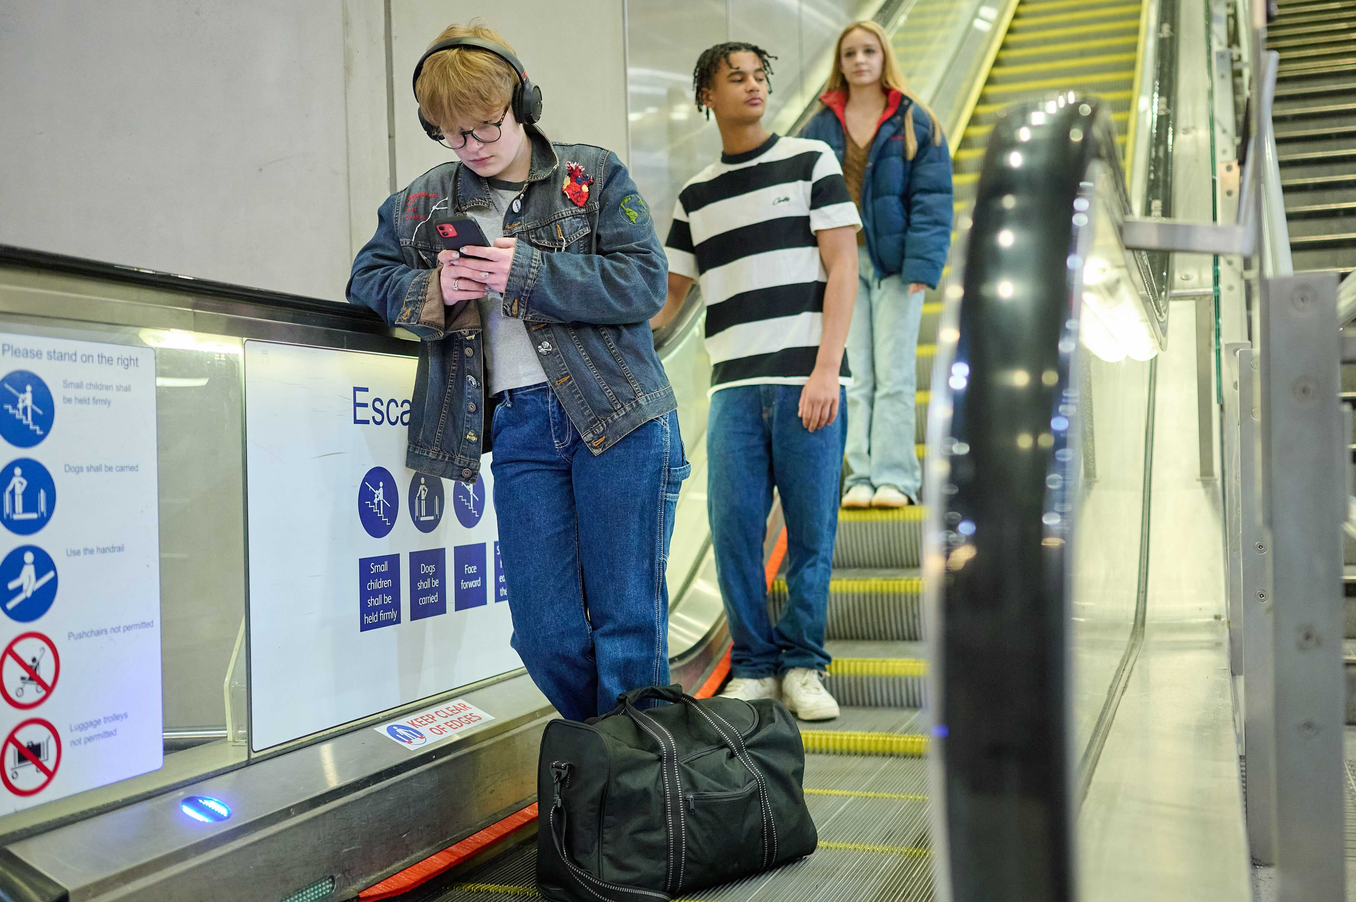
Escalator: Watch Out – Scene 1
www.switchedonrailsafety.co.uk
Track Back 6

Slide 7
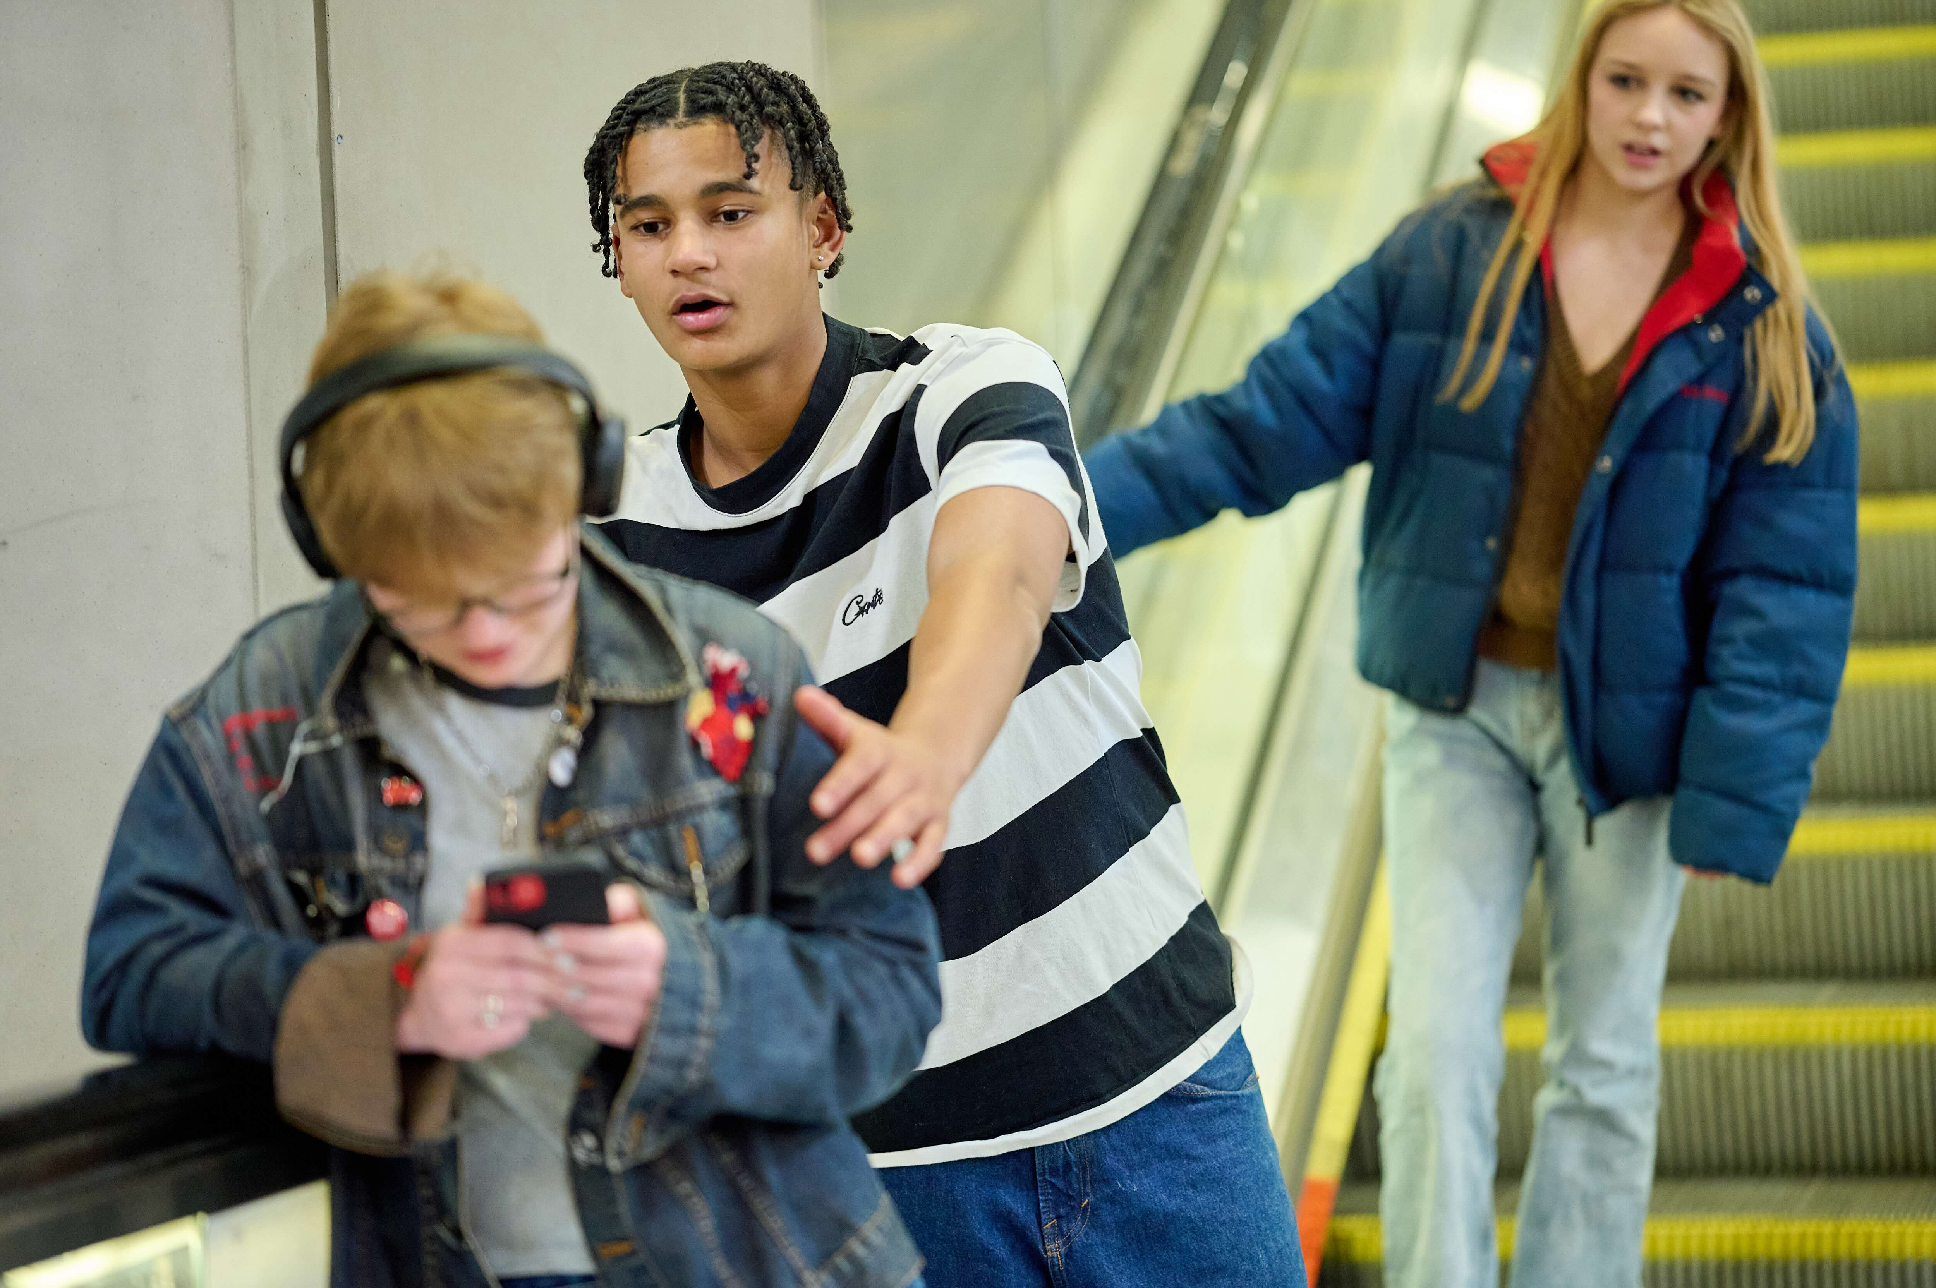
Escalator: Watch Out – Scene 2
www.switchedonrailsafety.co.uk
Track Back 7

Slide 8


Slide 9
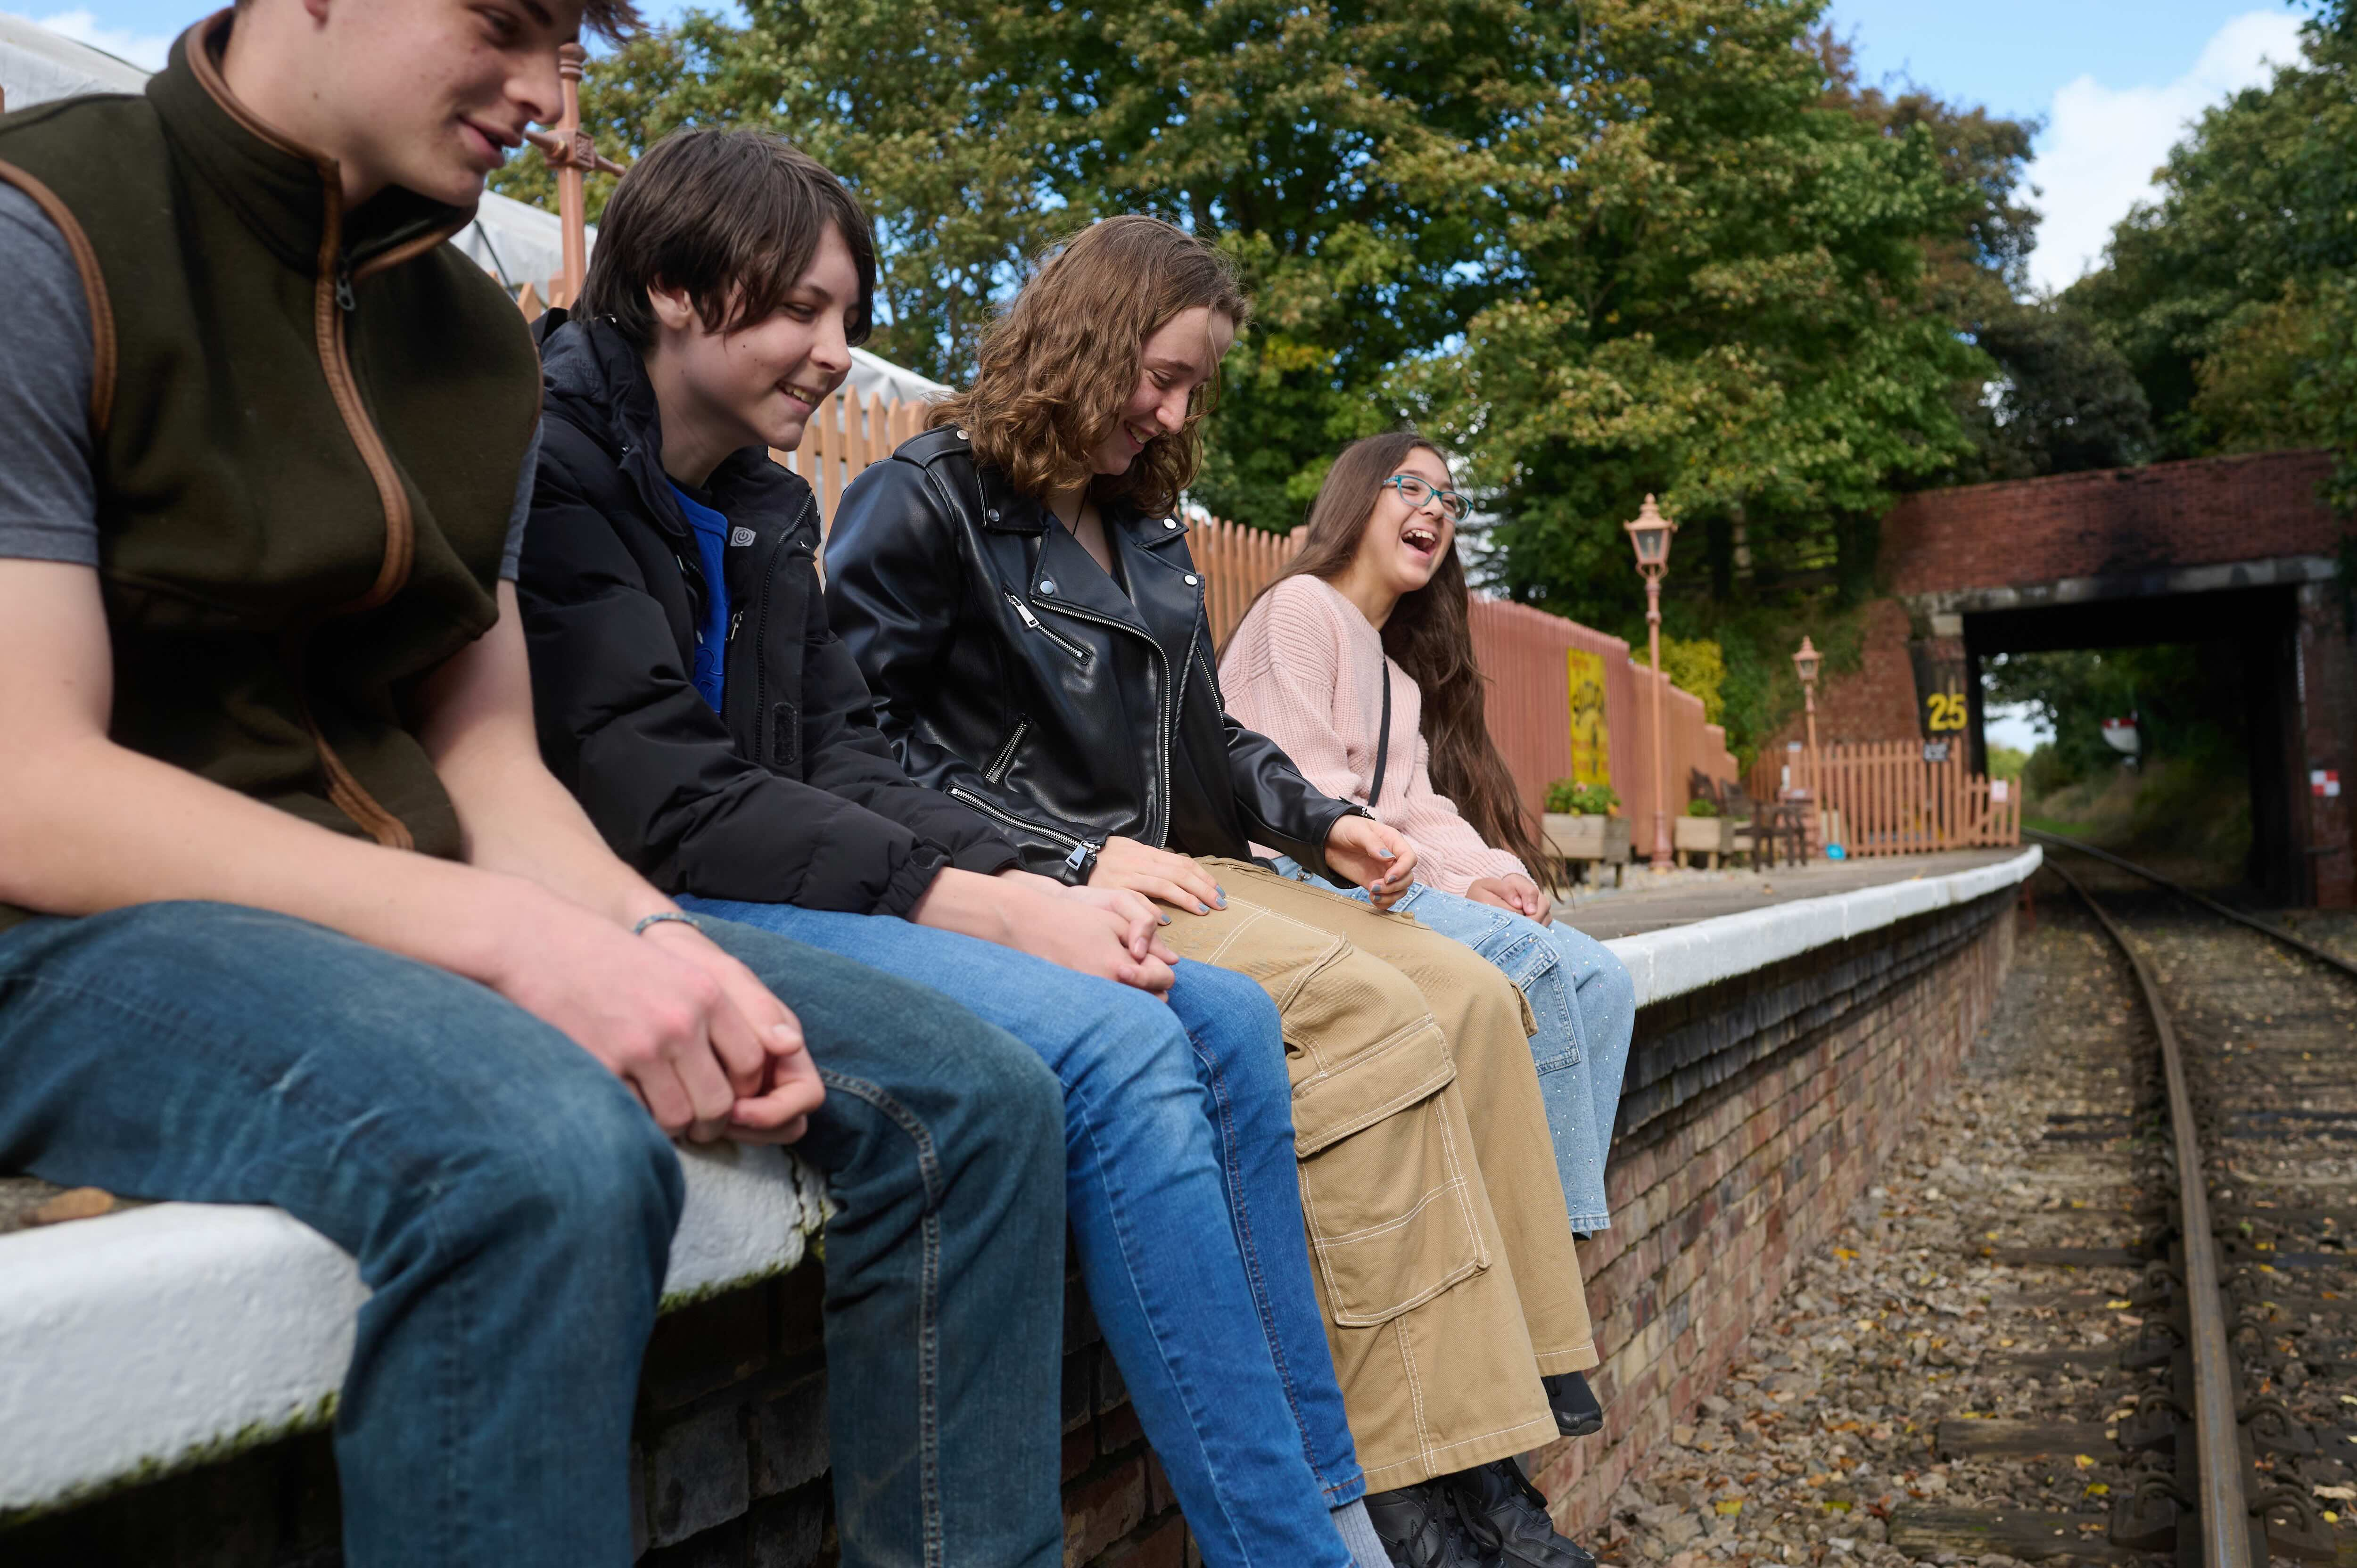
Platform: Dangling Legs – Scene 1
www.switchedonrailsafety.co.uk
Track Back 9

Slide 10
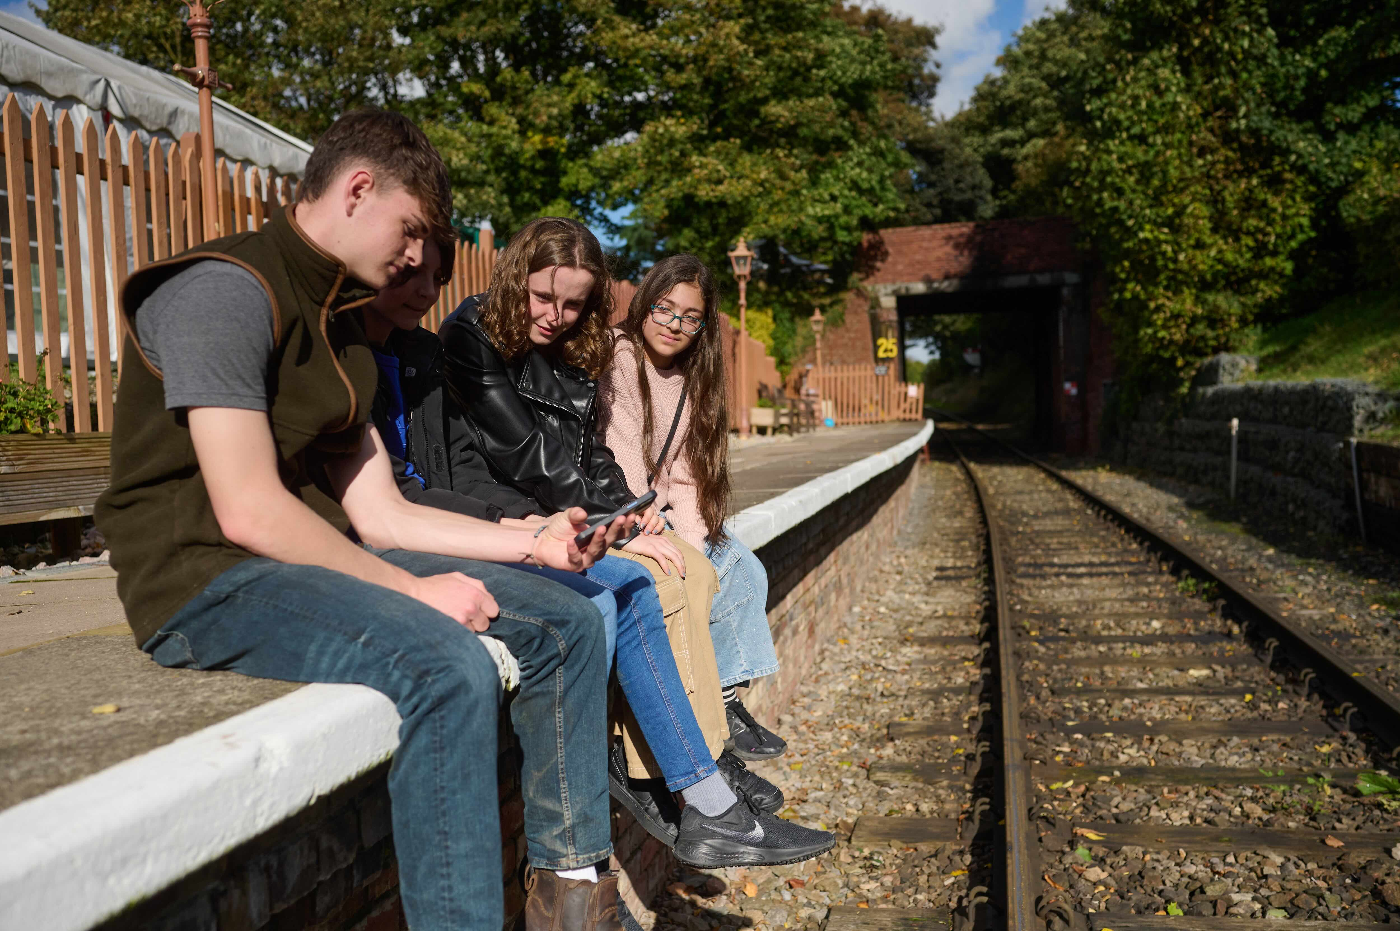
Platform: Dangling Legs – Scene 2
www.switchedonrailsafety.co.uk
Track Back 10

Slide 11
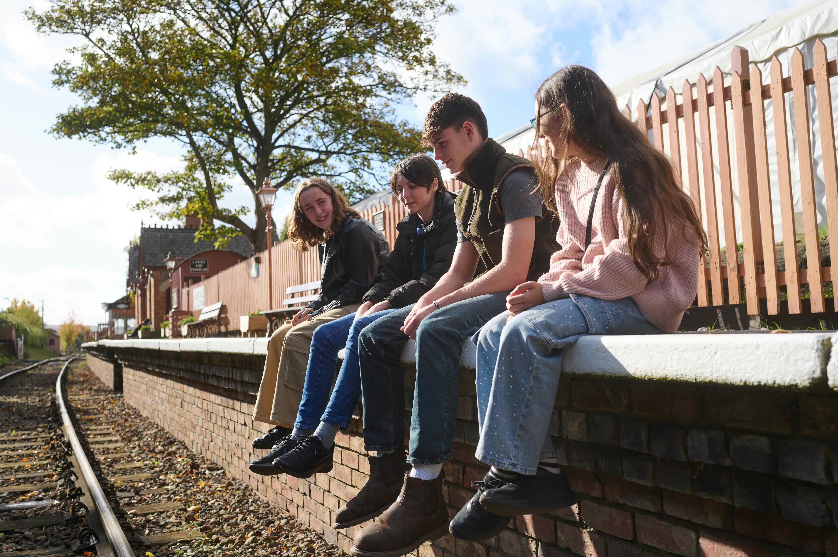
Platform: Dangling Legs – Scene 2
www.switchedonrailsafety.co.uk
Track Back 11

Slide 12


Slide 13
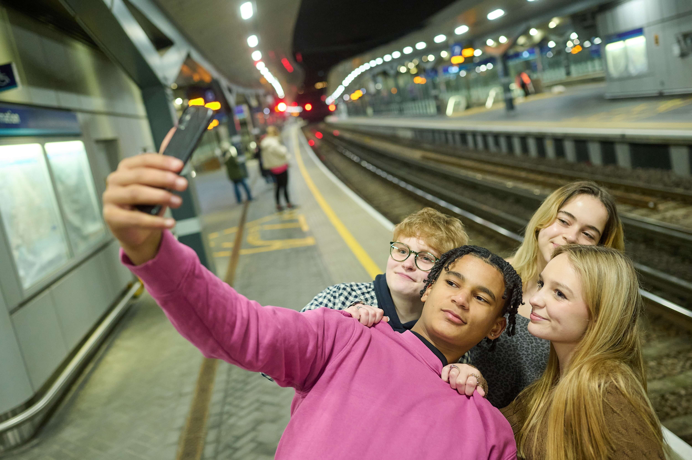
Platform: Selfish Selfies – Scene 1
www.switchedonrailsafety.co.uk
Track Back 13

Slide 14
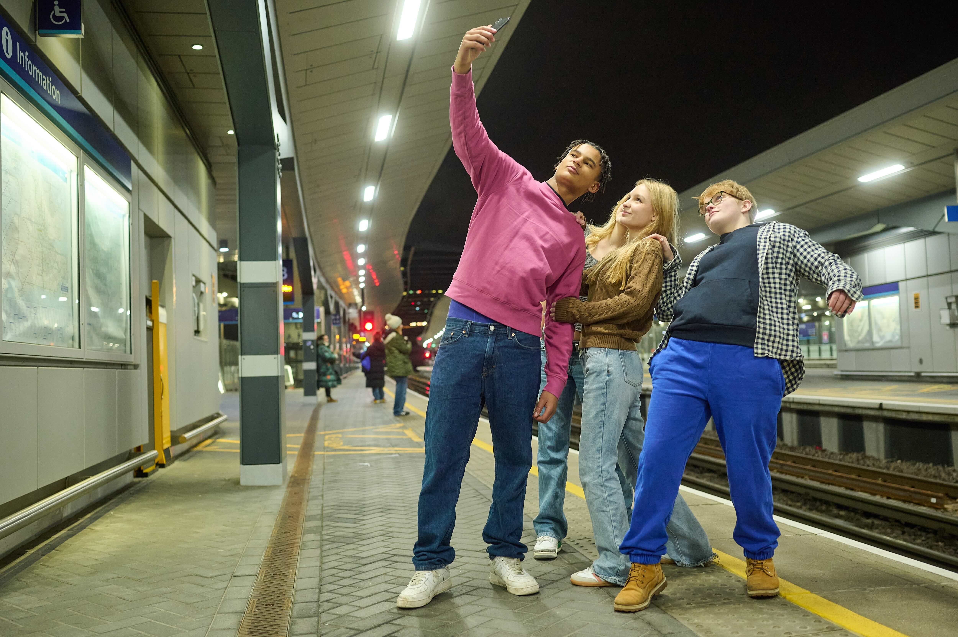
Platform: Selfish Selfies – Scene 2
www.switchedonrailsafety.co.uk
Track Back 14

